Slide 1


Domain-Specific Languages
Mathieu Acher
Maître de Conférences
mathieu.acher@irisa.fr

Slide 2
Material
https://github.com/acherm/teaching-MDE-MIAGE1718

Slide 3
IDM (MDE)
in practice

Slide 4
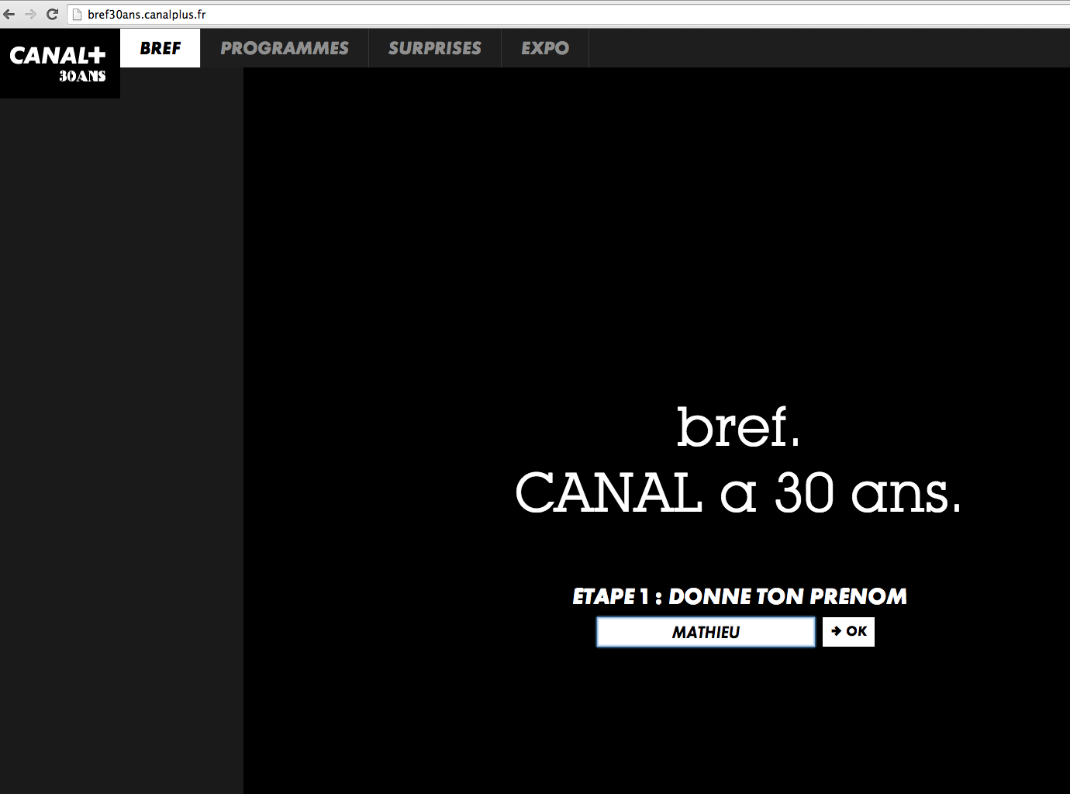

Slide 5
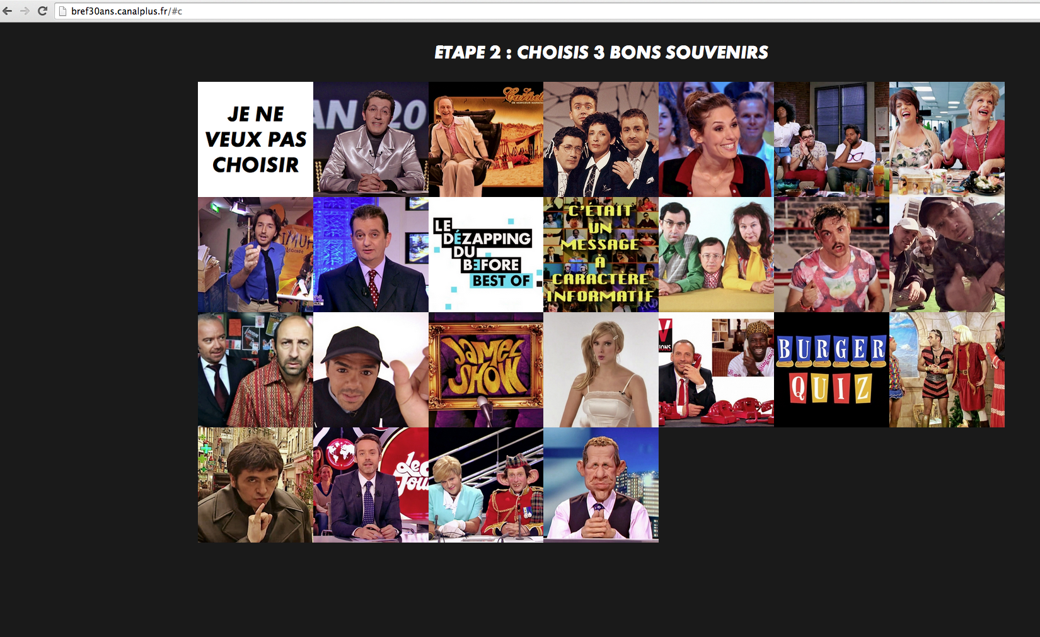
Online Generator

Slide 6
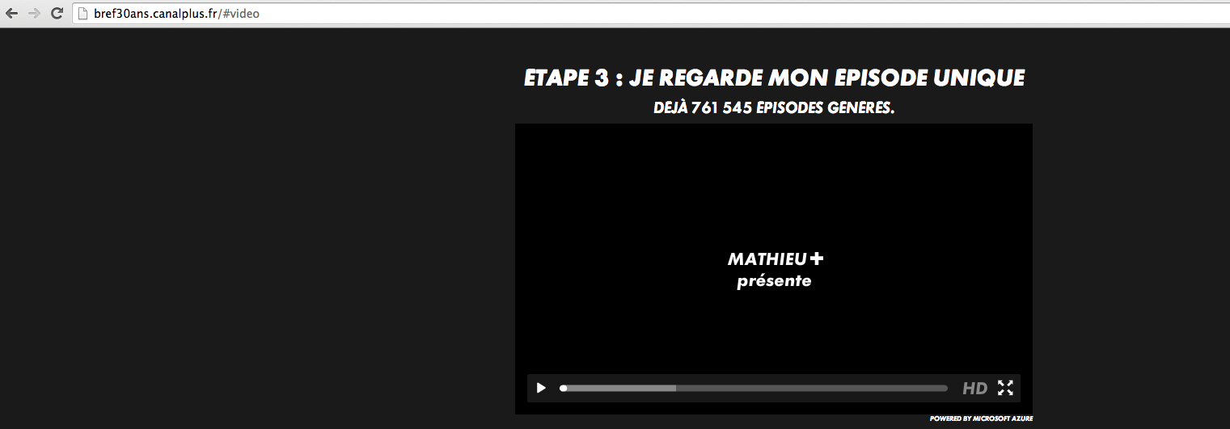
Variant
Guillaume Bécan, Mathieu Acher, Jean-Marc Jézéquel, and Thomas Menguy. On the Variability Secrets of an Online Video Generator (2015). In VaMoS'15

Slide 7
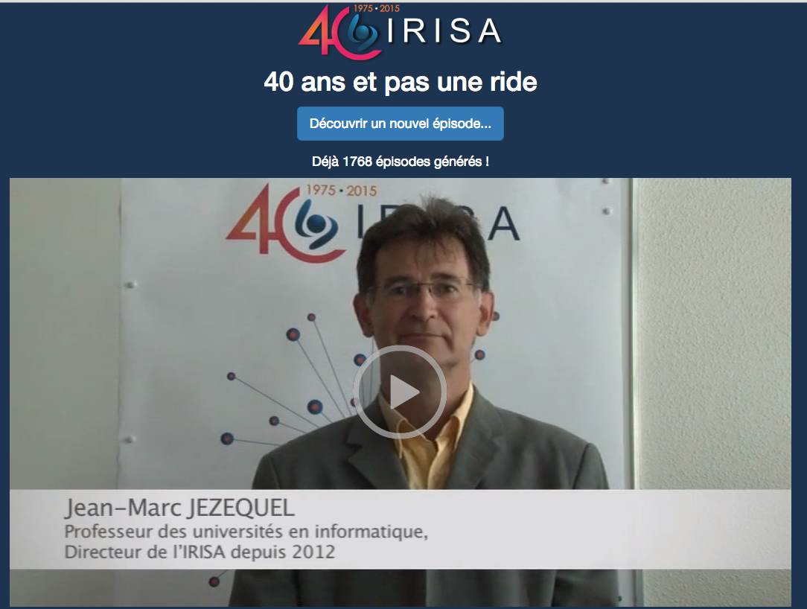

Slide 8
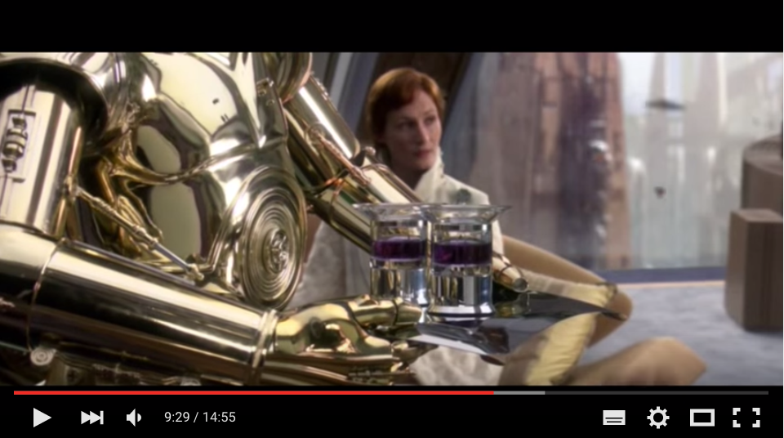
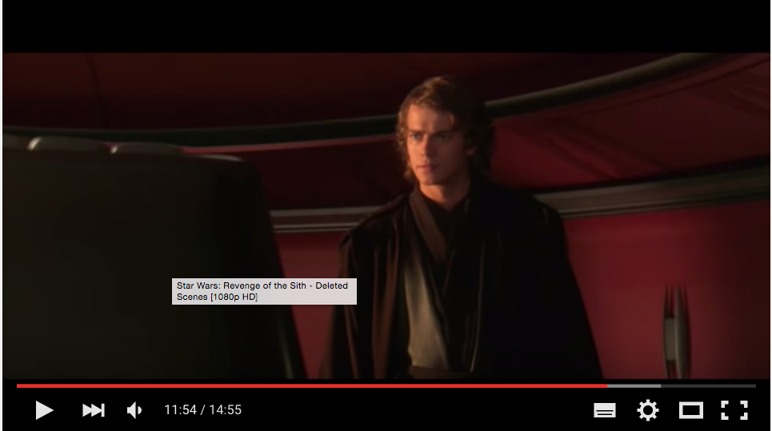
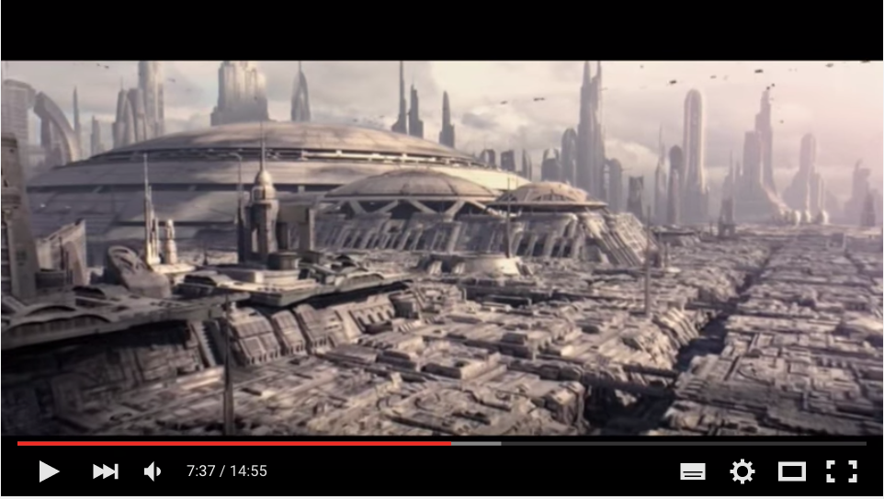



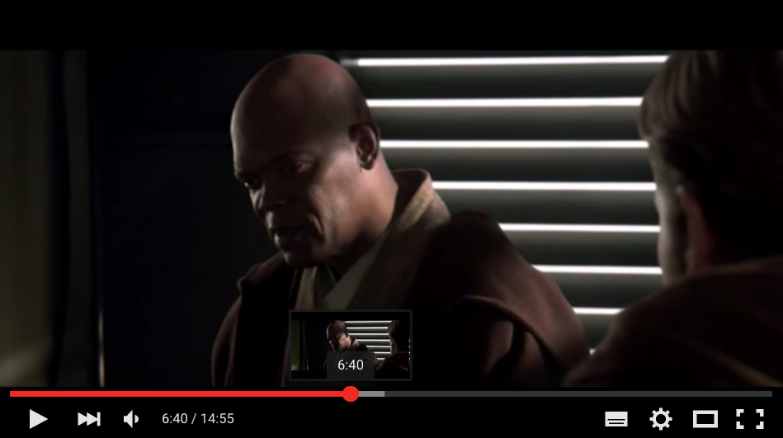
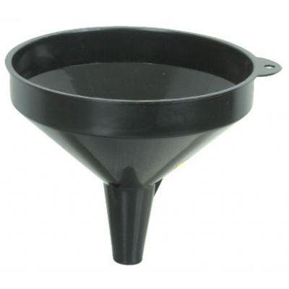
Generator
~ composition of video sequences
video variants

Slide 9

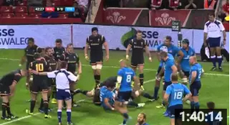
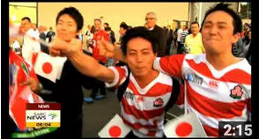
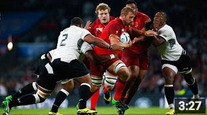
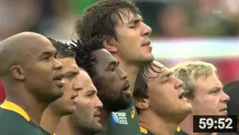

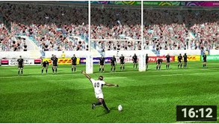
Generator
~ composition of video sequences
video variants

Slide 10
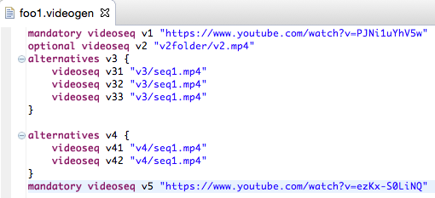
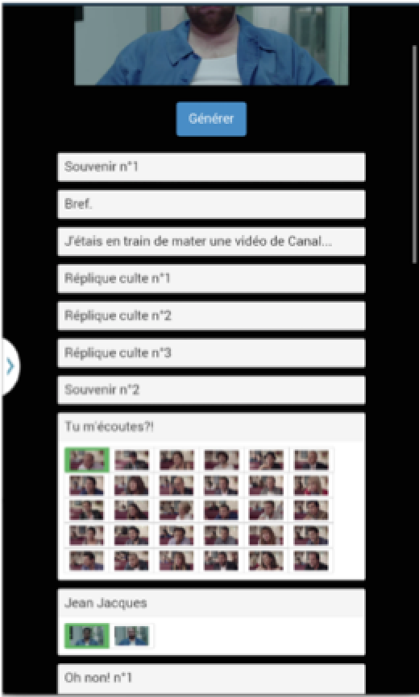
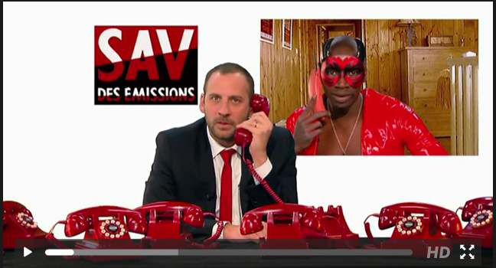
Website/online
Random generation
Configurator
Game
…

Slide 11
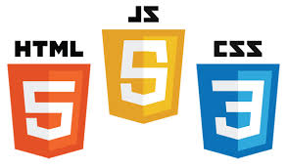






Slide 12
#1 How to design, create, and support dedicated languages (DSLs)?
#2 How to transform models/programs?
#3 How to manage variability/variants?
#4 How do frameworks internally work?

Slide 13
#1 How to design, create, and support dedicated languages (DSLs)?
#2 How to transform models/programs?
#3 How to manage variability/variants?
#4 How do frameworks internally work?

Slide 14
Plan
Domain-Specific Languages (DSLs)
Languages and abstraction gap
Examples and rationale
DSLs vs General purpose languages, taxonomy
External DSLs
Grammar and parsing
Xtext
DSLs, DSMLs, and (meta-)modeling

Slide 15
Contract
Better understanding/source of inspiration of software languages and DSLs
Revisit of history and existing languages
Foundations and practice of Xtext
State-of-the-art language workbench (Most Innovative Eclipse Project in 2010, mature and used in a variety of industries)
Models and Languages
Perhaps a more concrete way to see models, metamodels and MDE (IDM in french)

Slide 16
What are DSLs
Where are DSLs
Why DSLs (will) matter

Slide 17
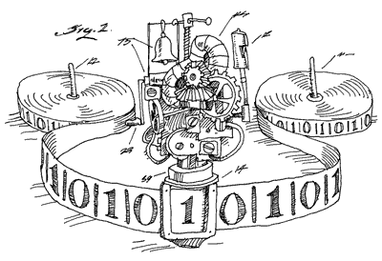

The (Hi)Story of Software Engineering / Computer Science
1937

Slide 18

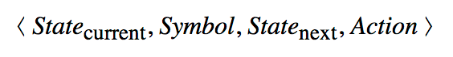
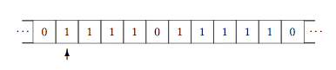
Turing Machine
Infinite tape divided into Cells (0 or 1)
Read-Write Head
Transitition rules
Write a symbol
or move to left (>>) or right (<<)

Slide 19
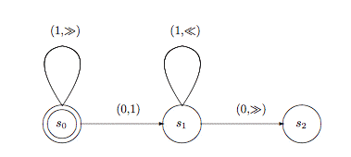
Turing Machine ~ kind of state machine

Slide 20
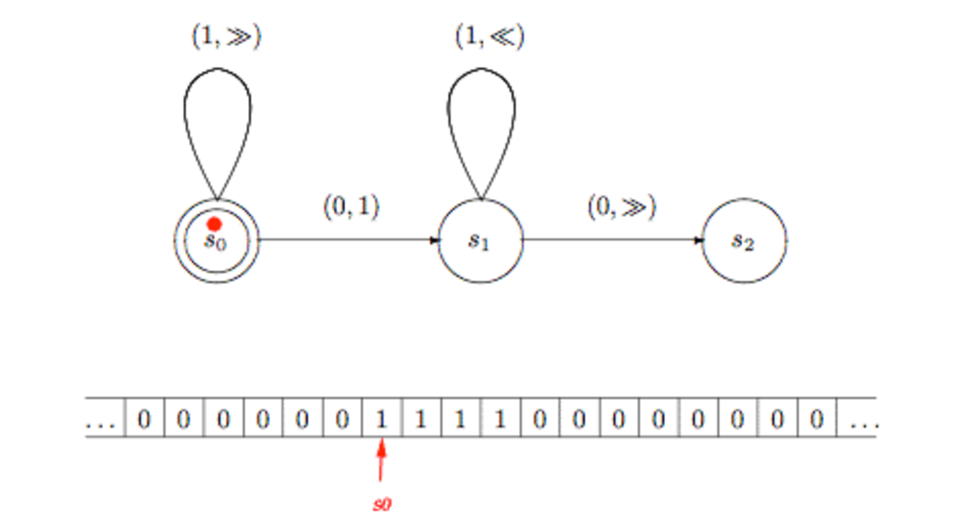
Successor (add-one) function assuming that number n as a block of n+1 copies of the symbol ‘1’ on the tape (here, n=3)

Slide 21
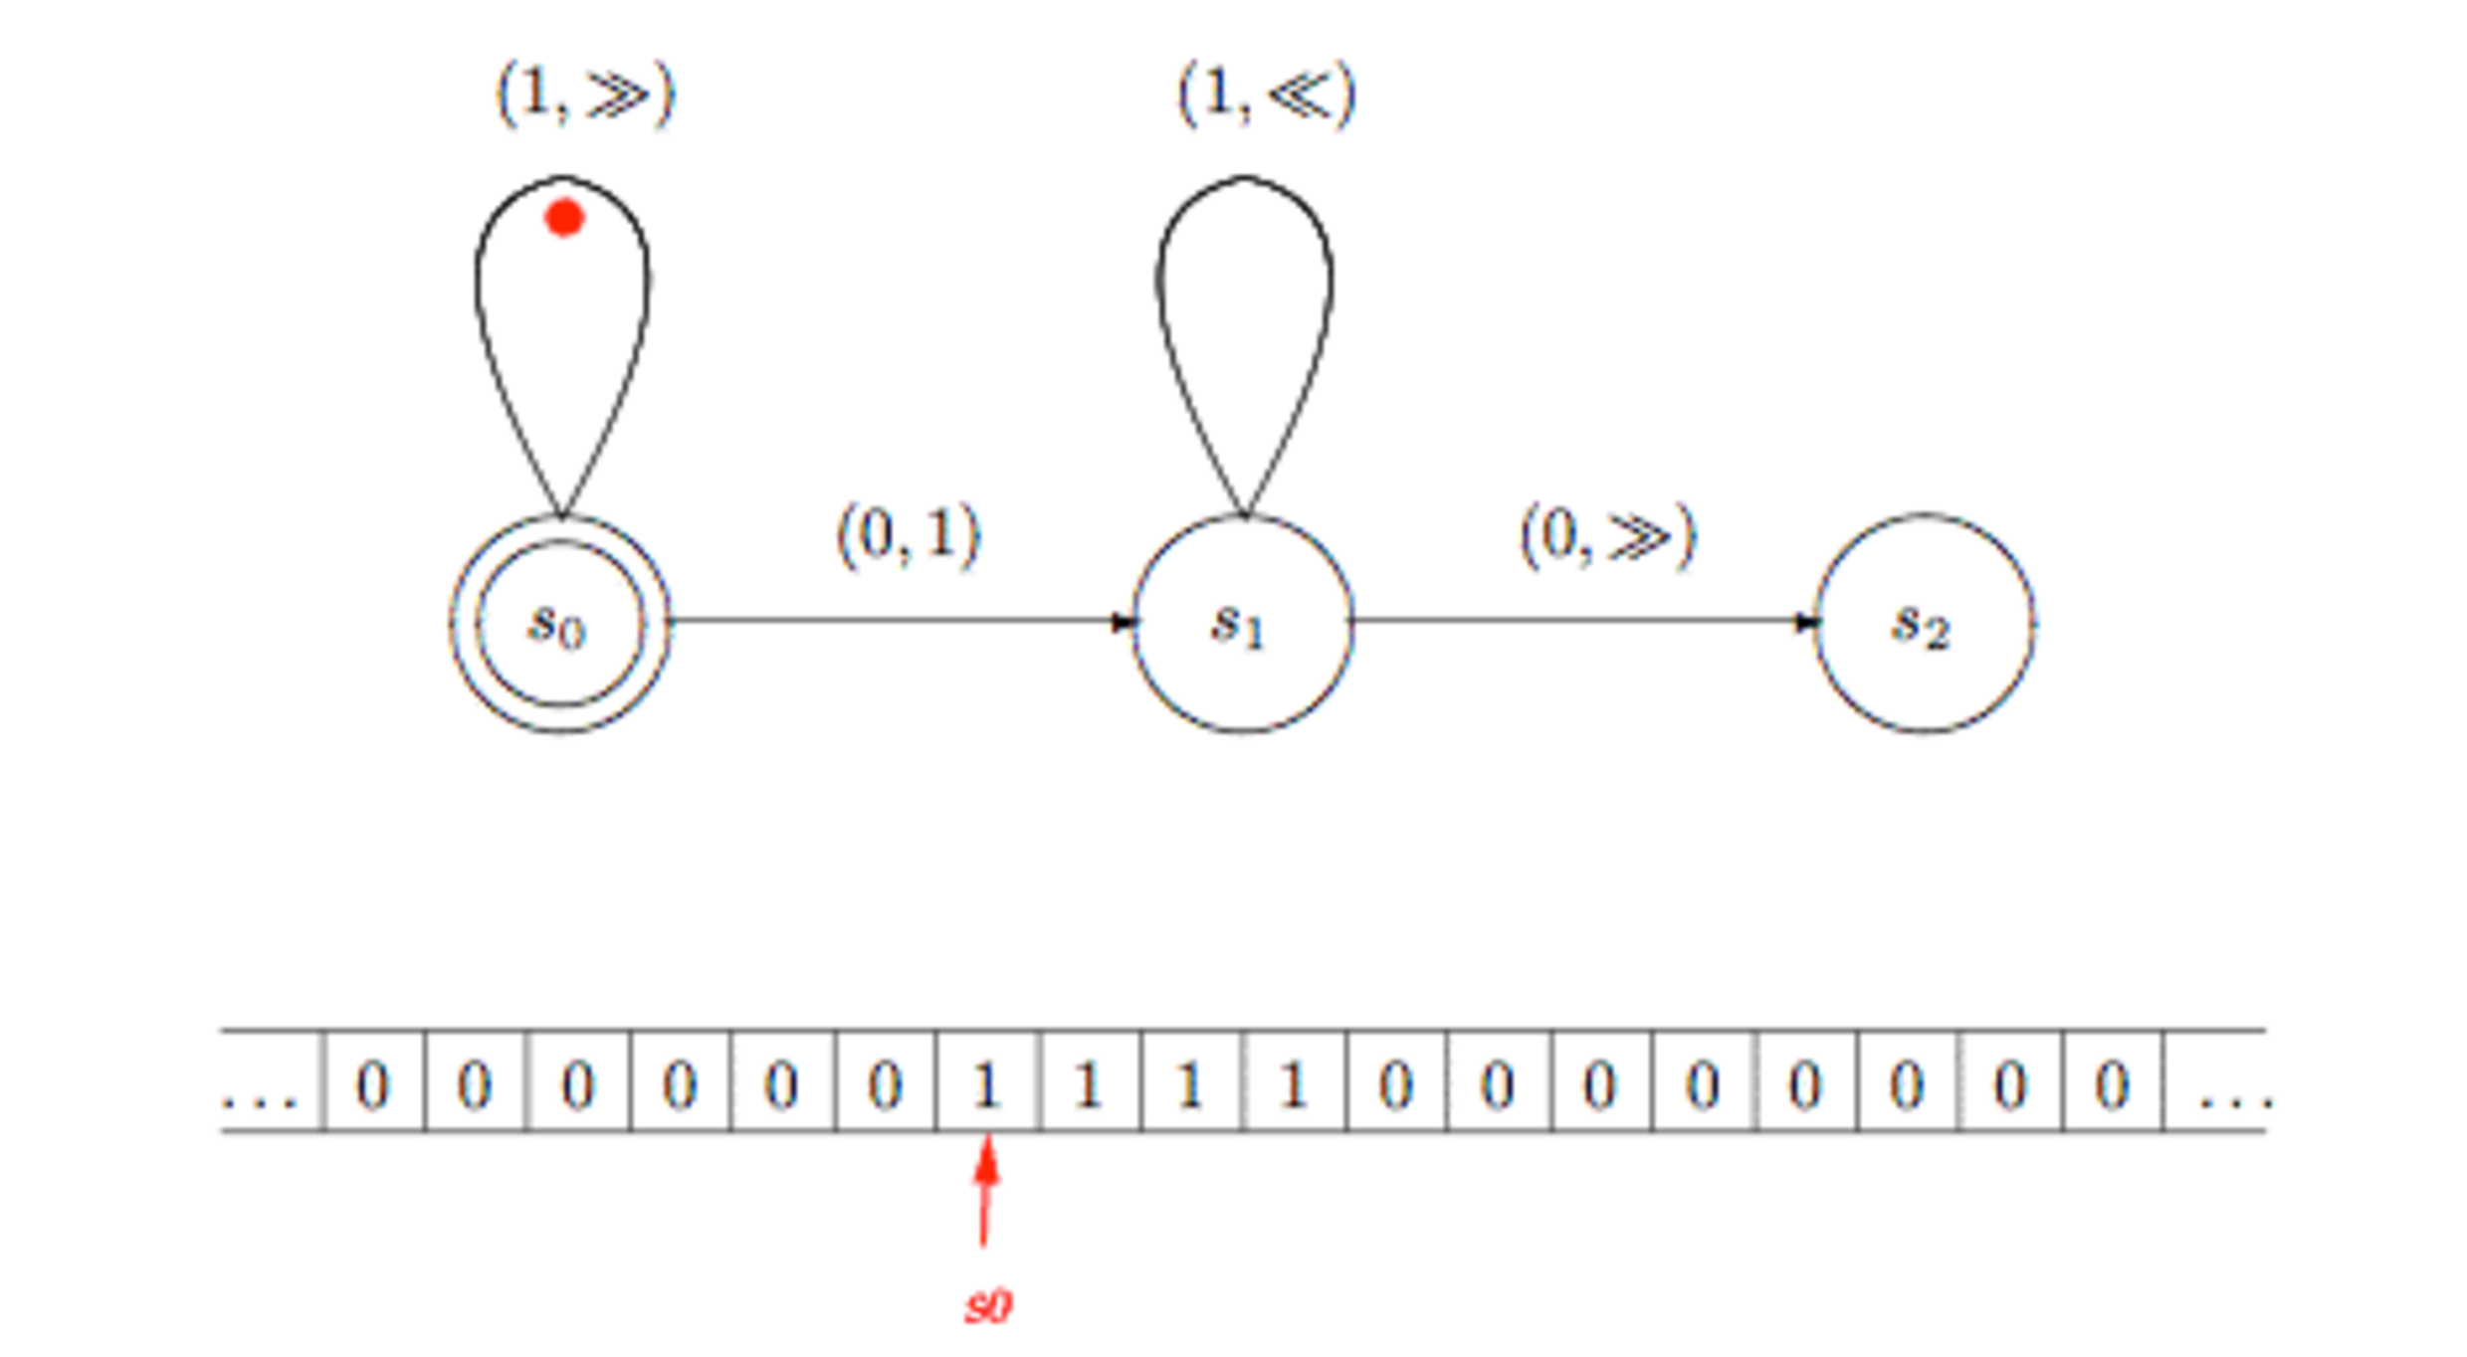

Slide 22
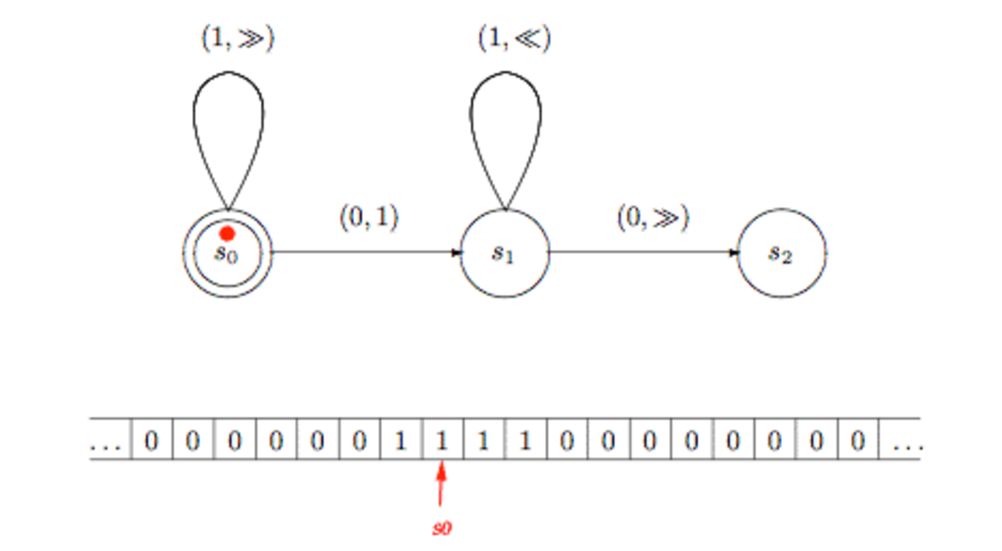

Slide 23
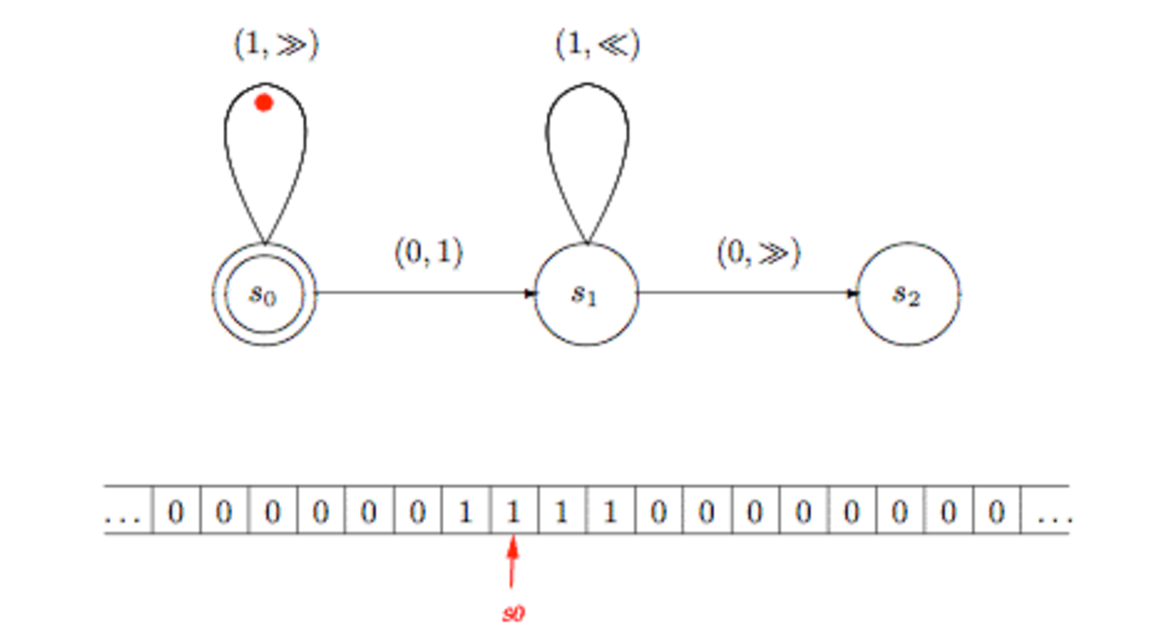

Slide 24
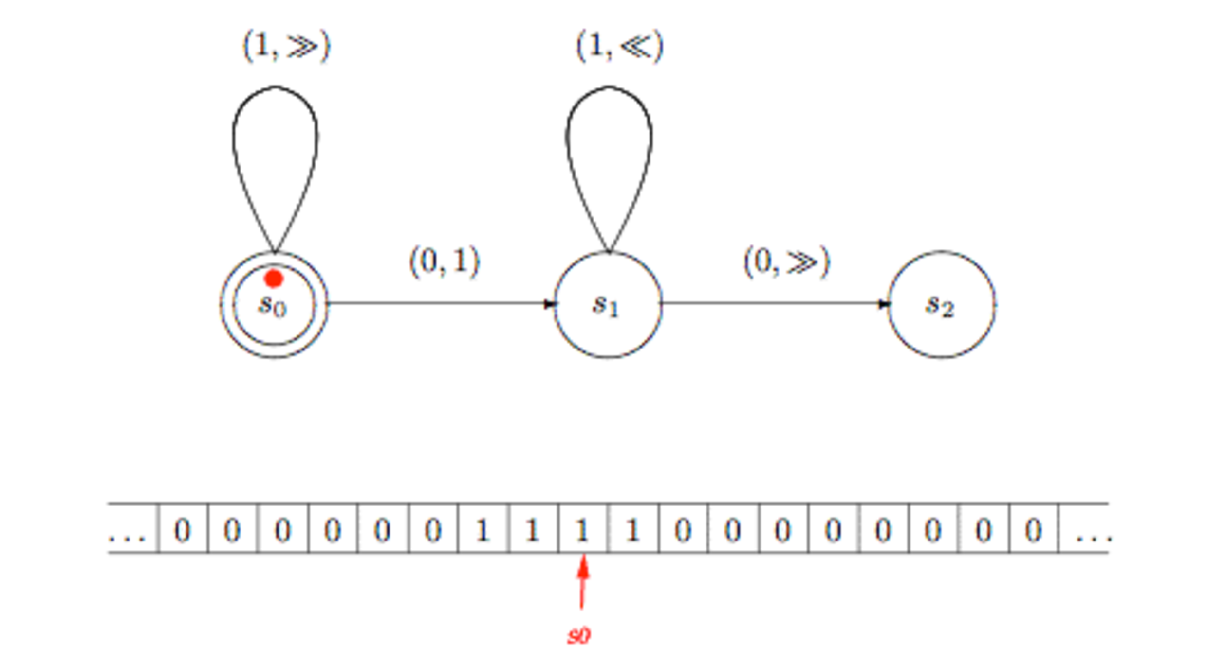

Slide 25
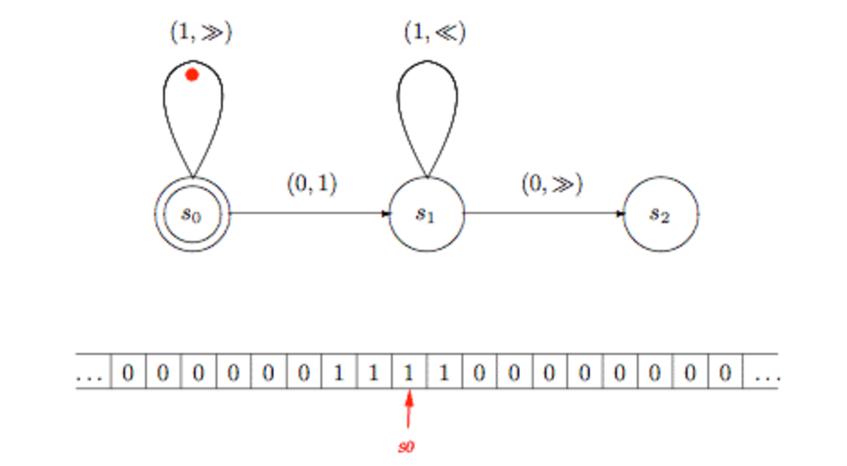

Slide 26
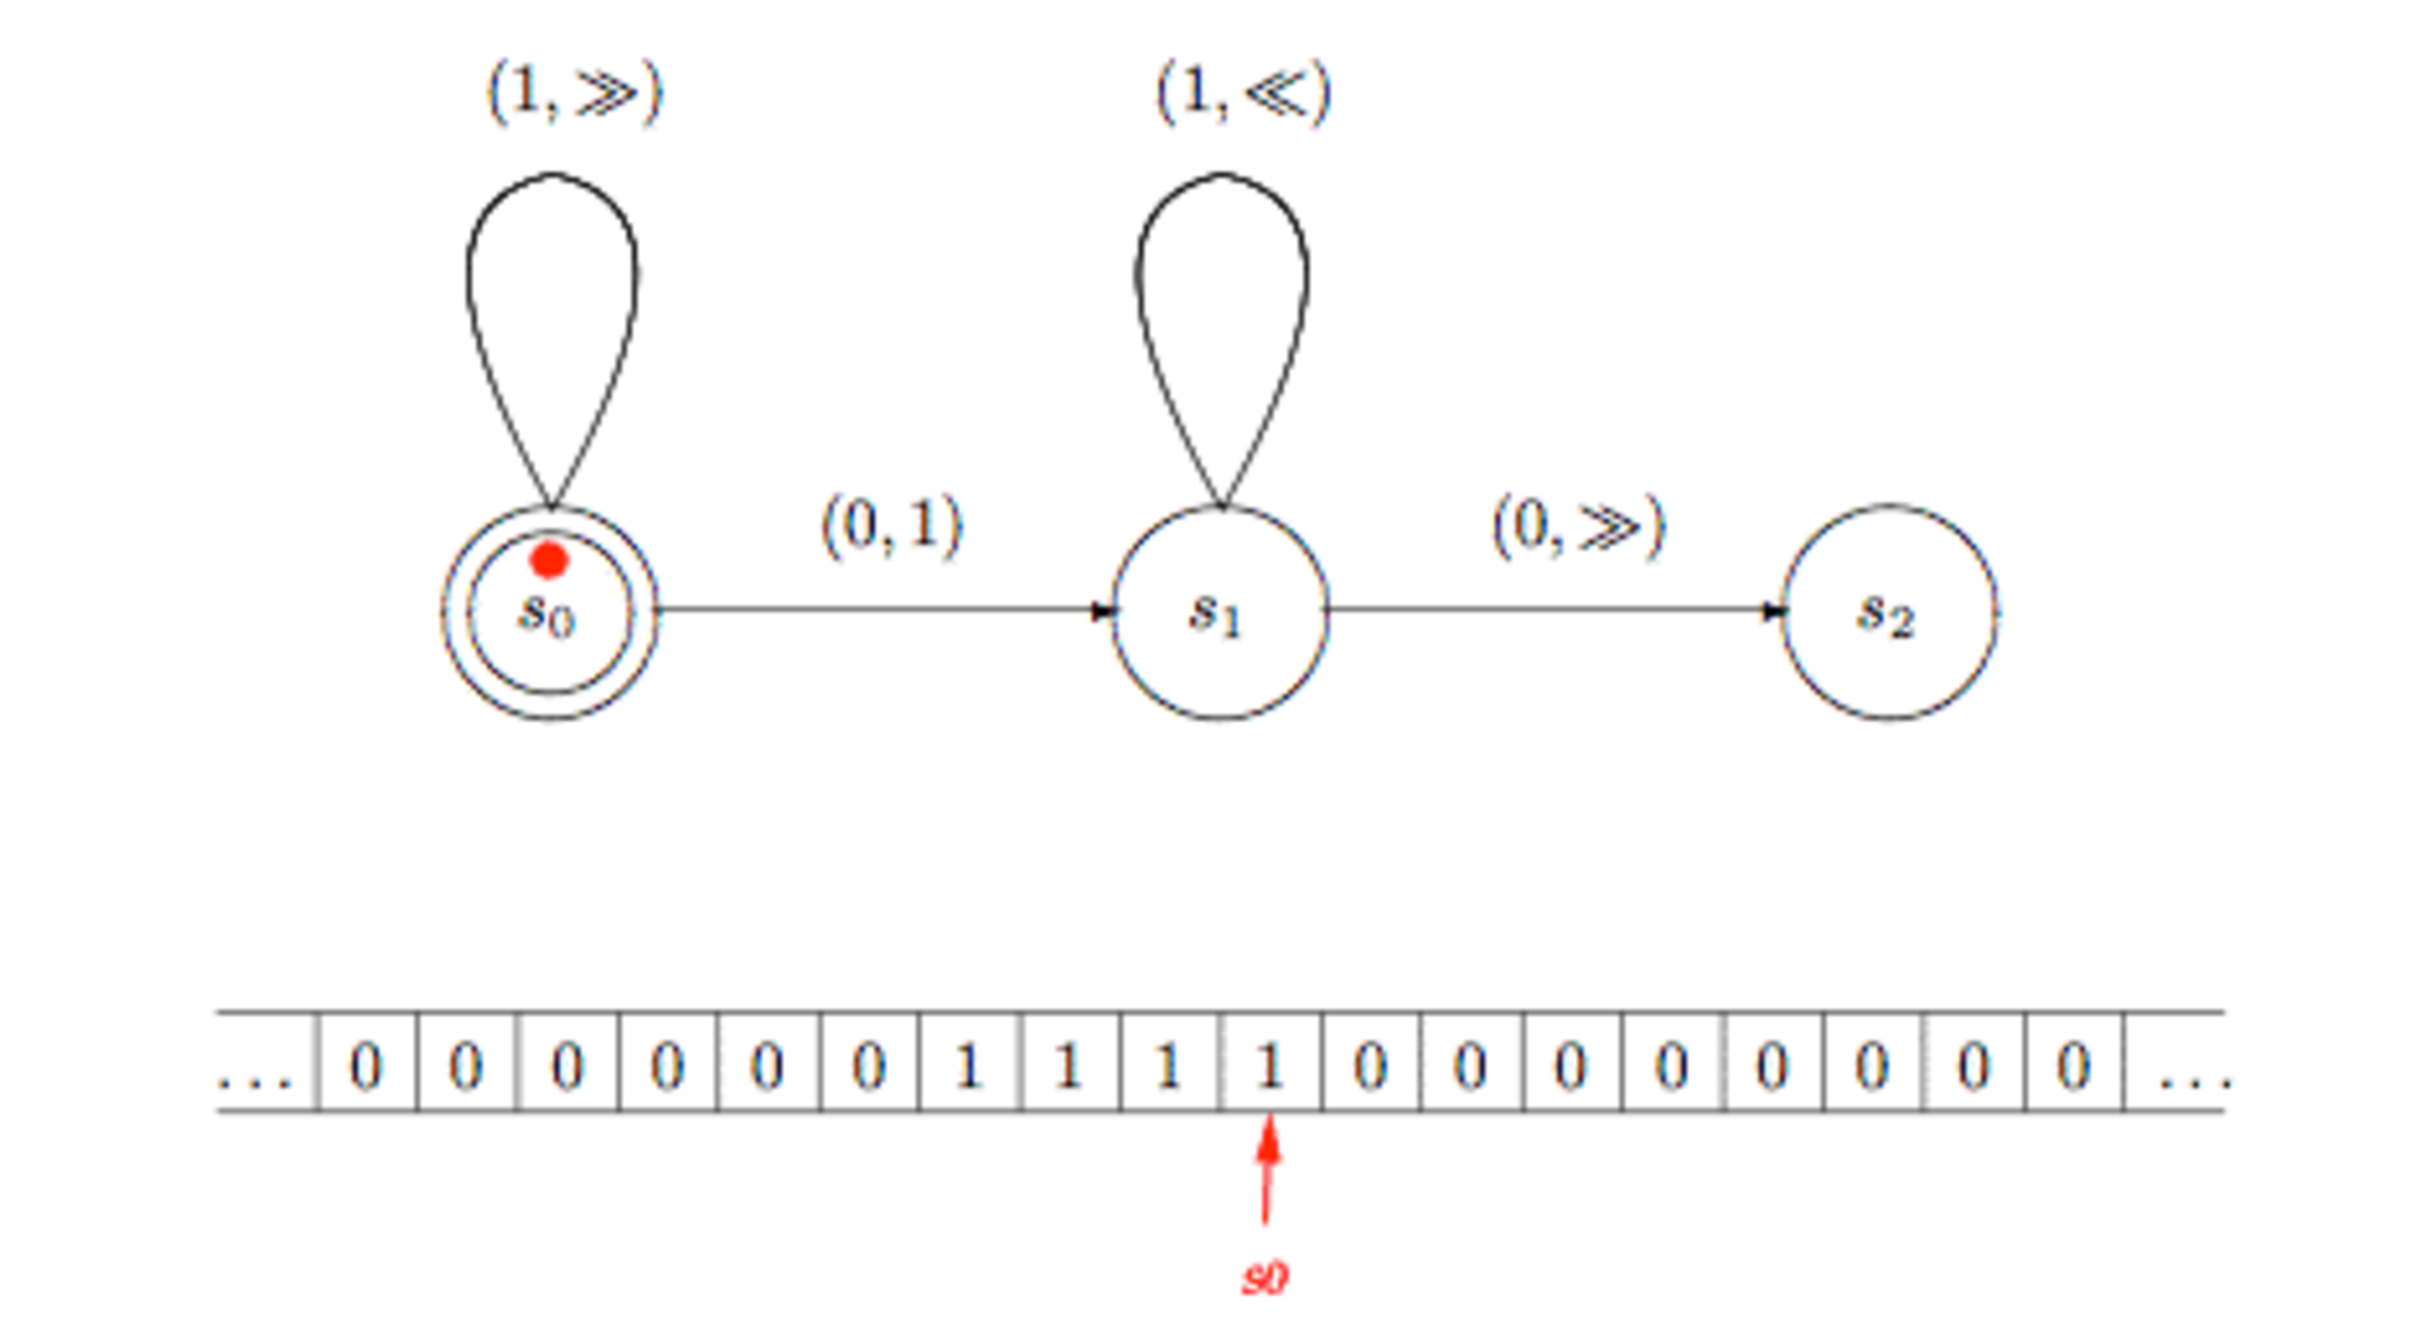

Slide 27
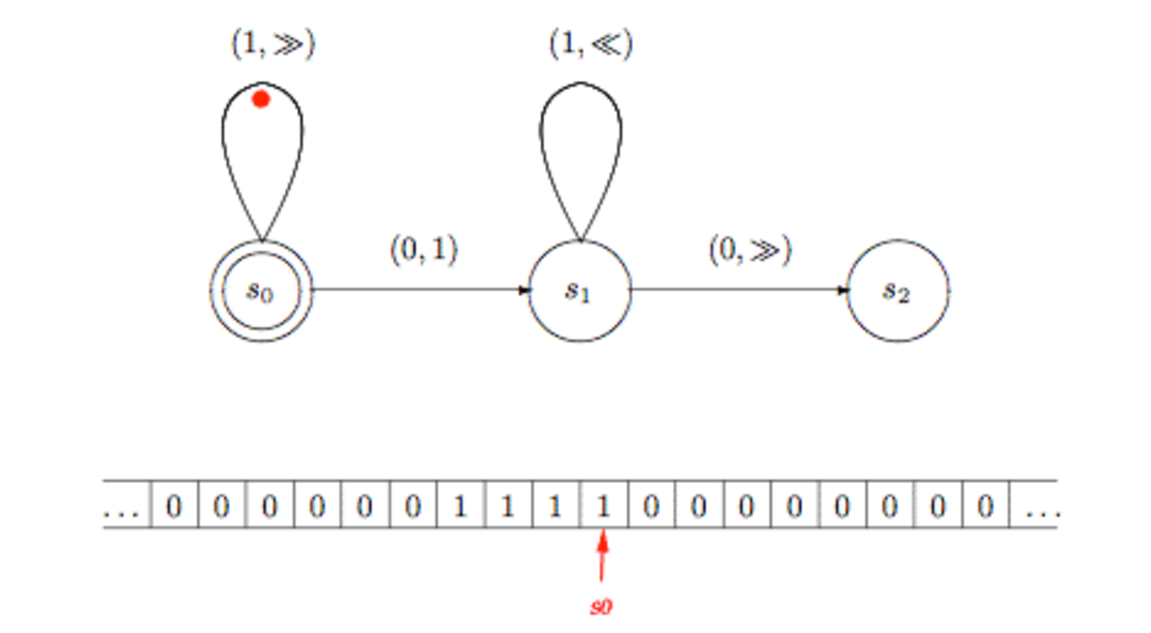

Slide 28
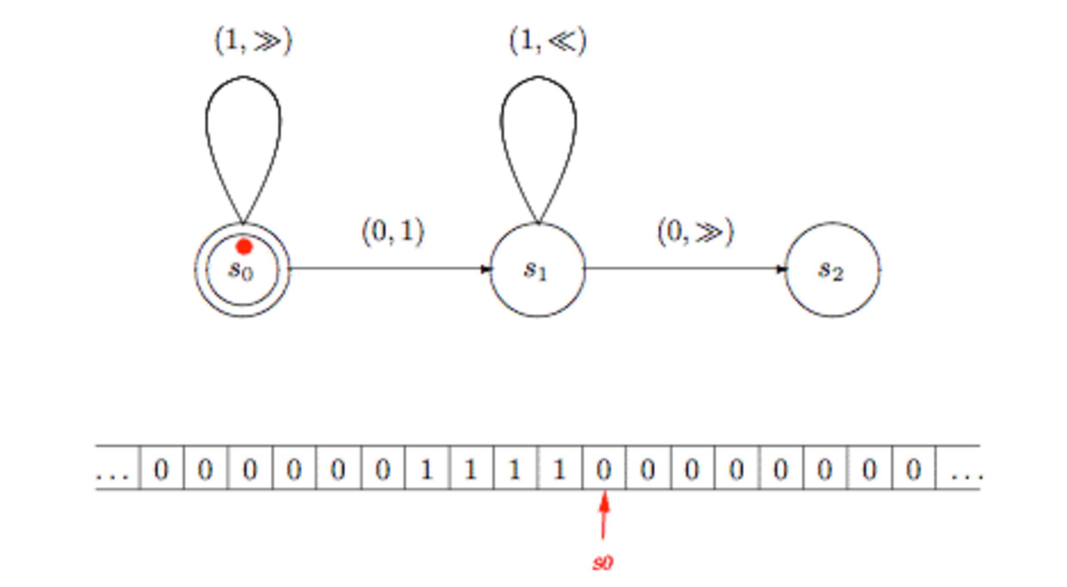

Slide 29
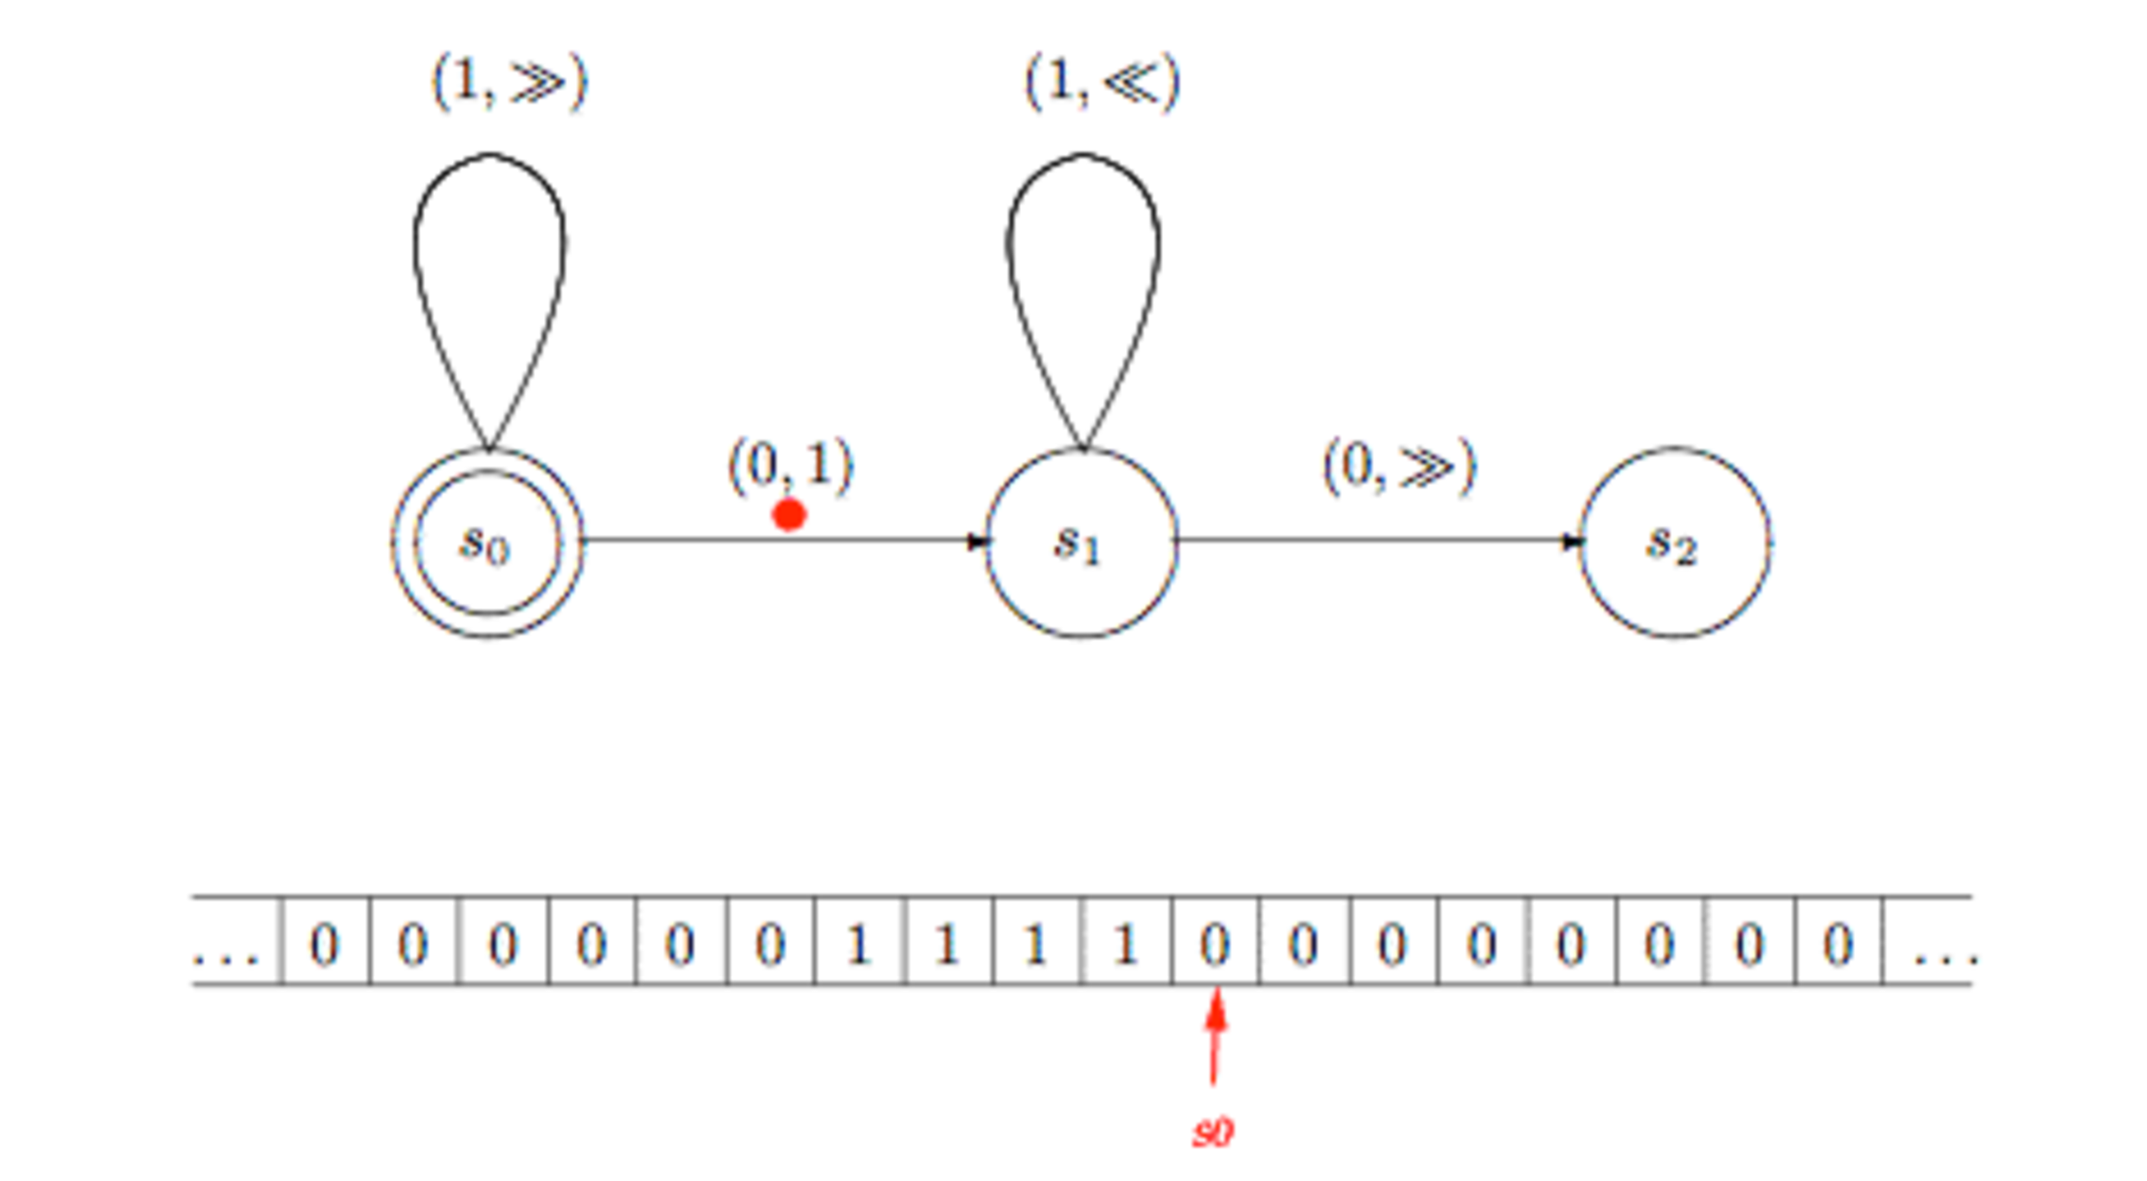

Slide 30
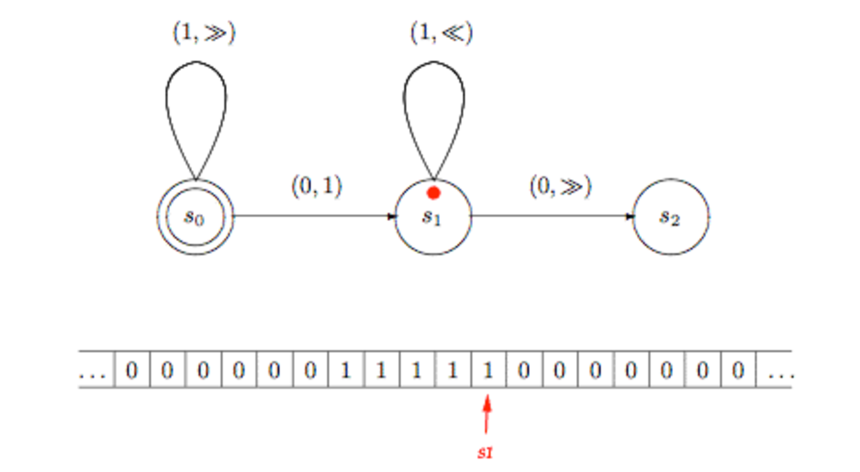

Slide 31
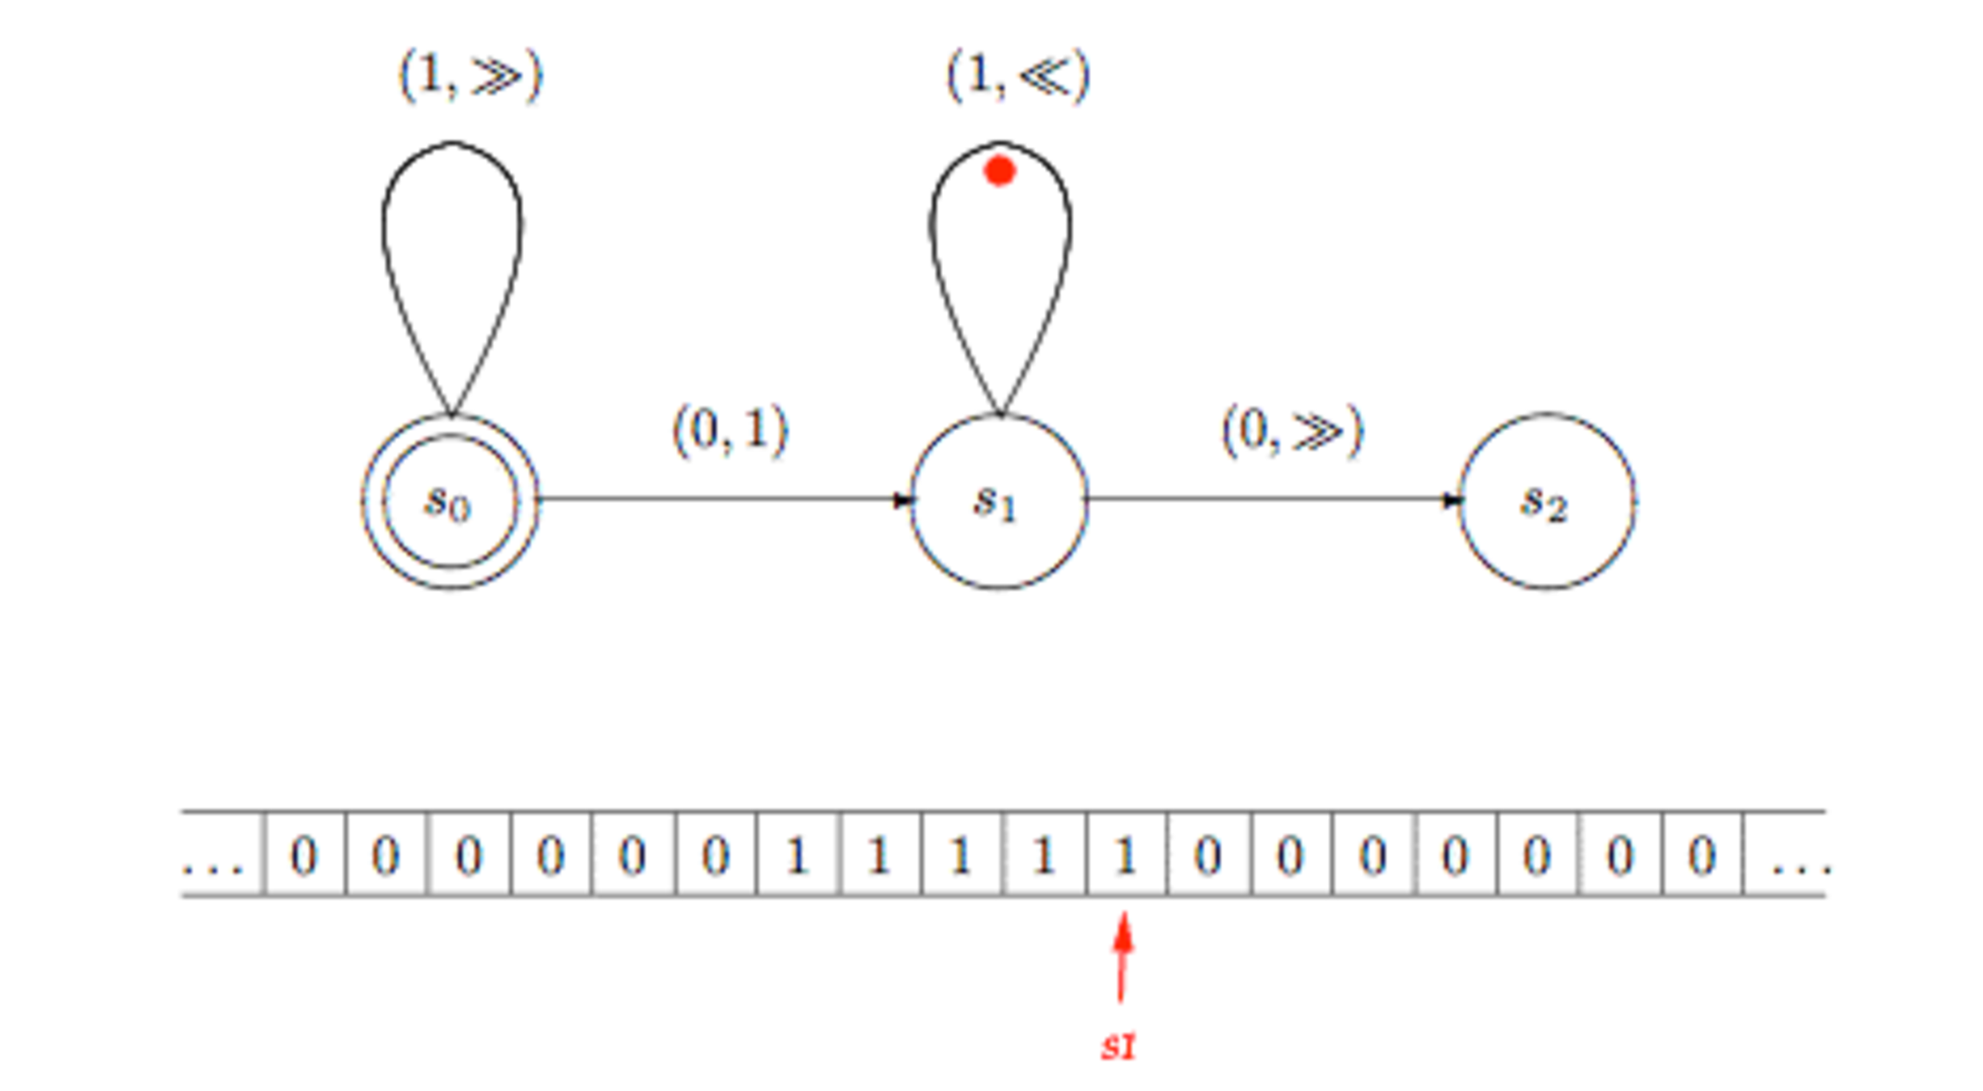

Slide 32
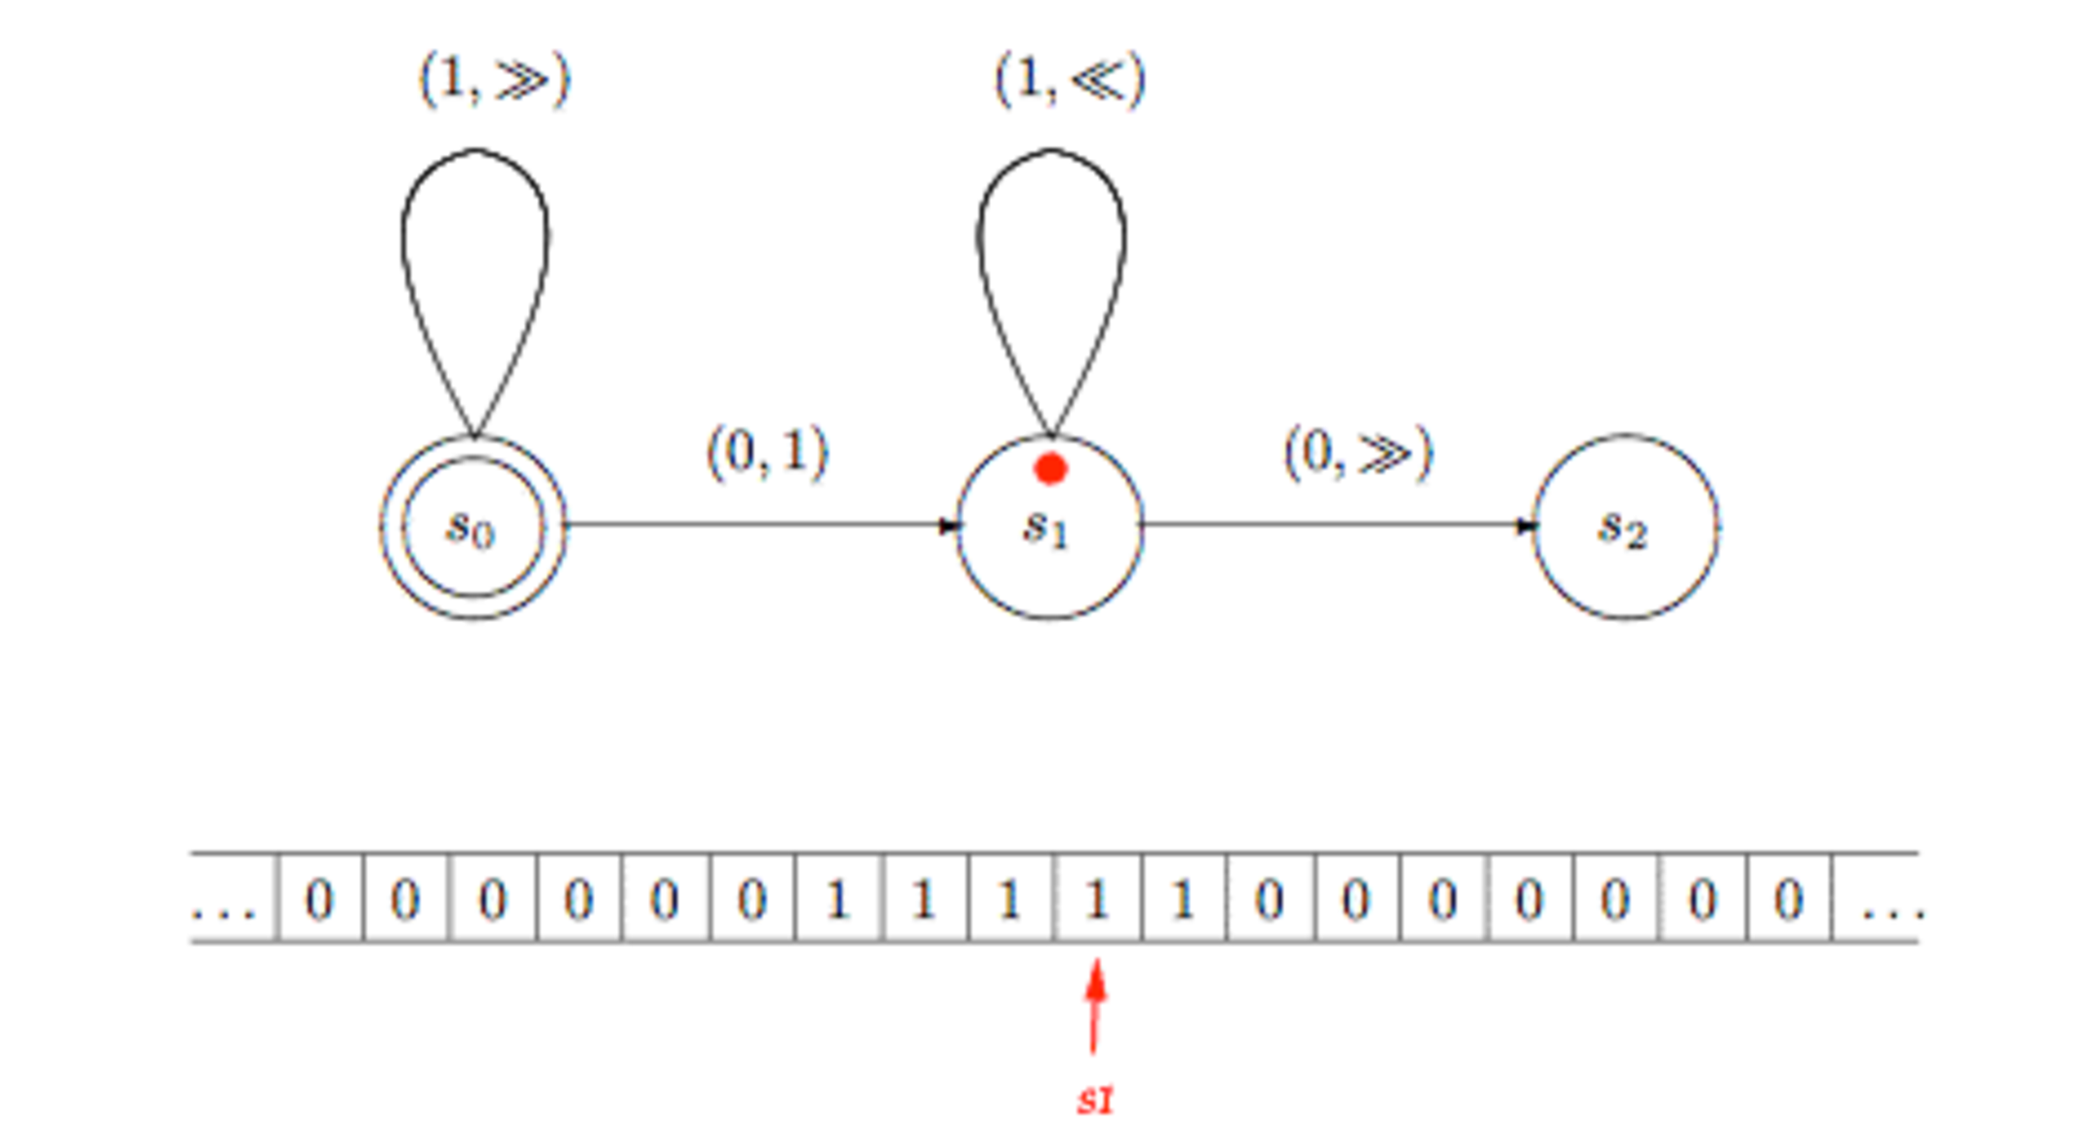

Slide 33
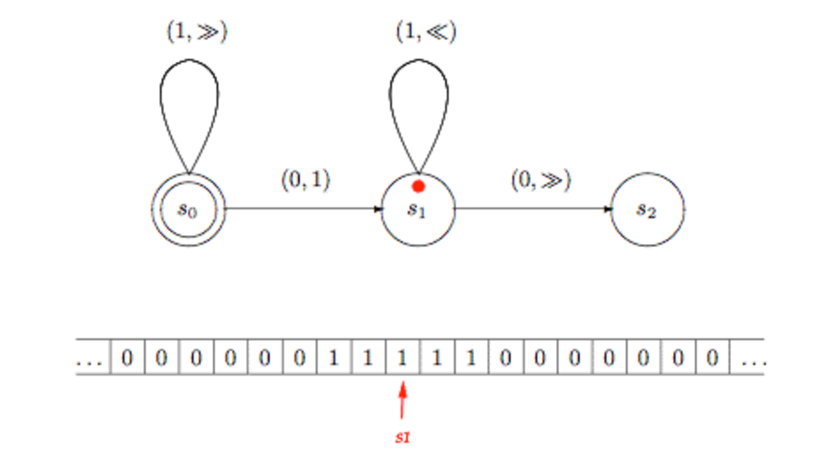

Slide 34
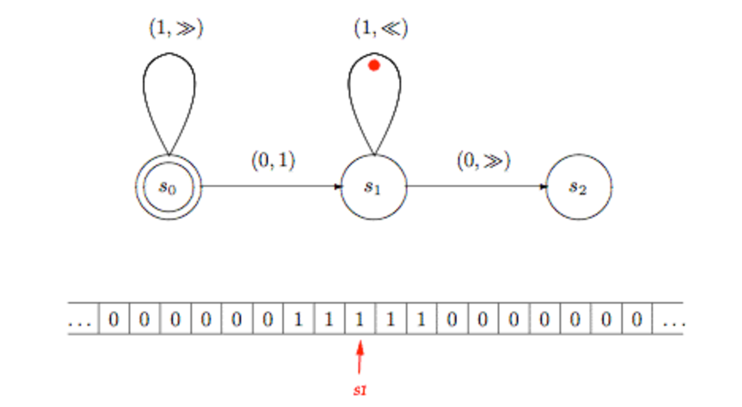

Slide 35


Slide 36
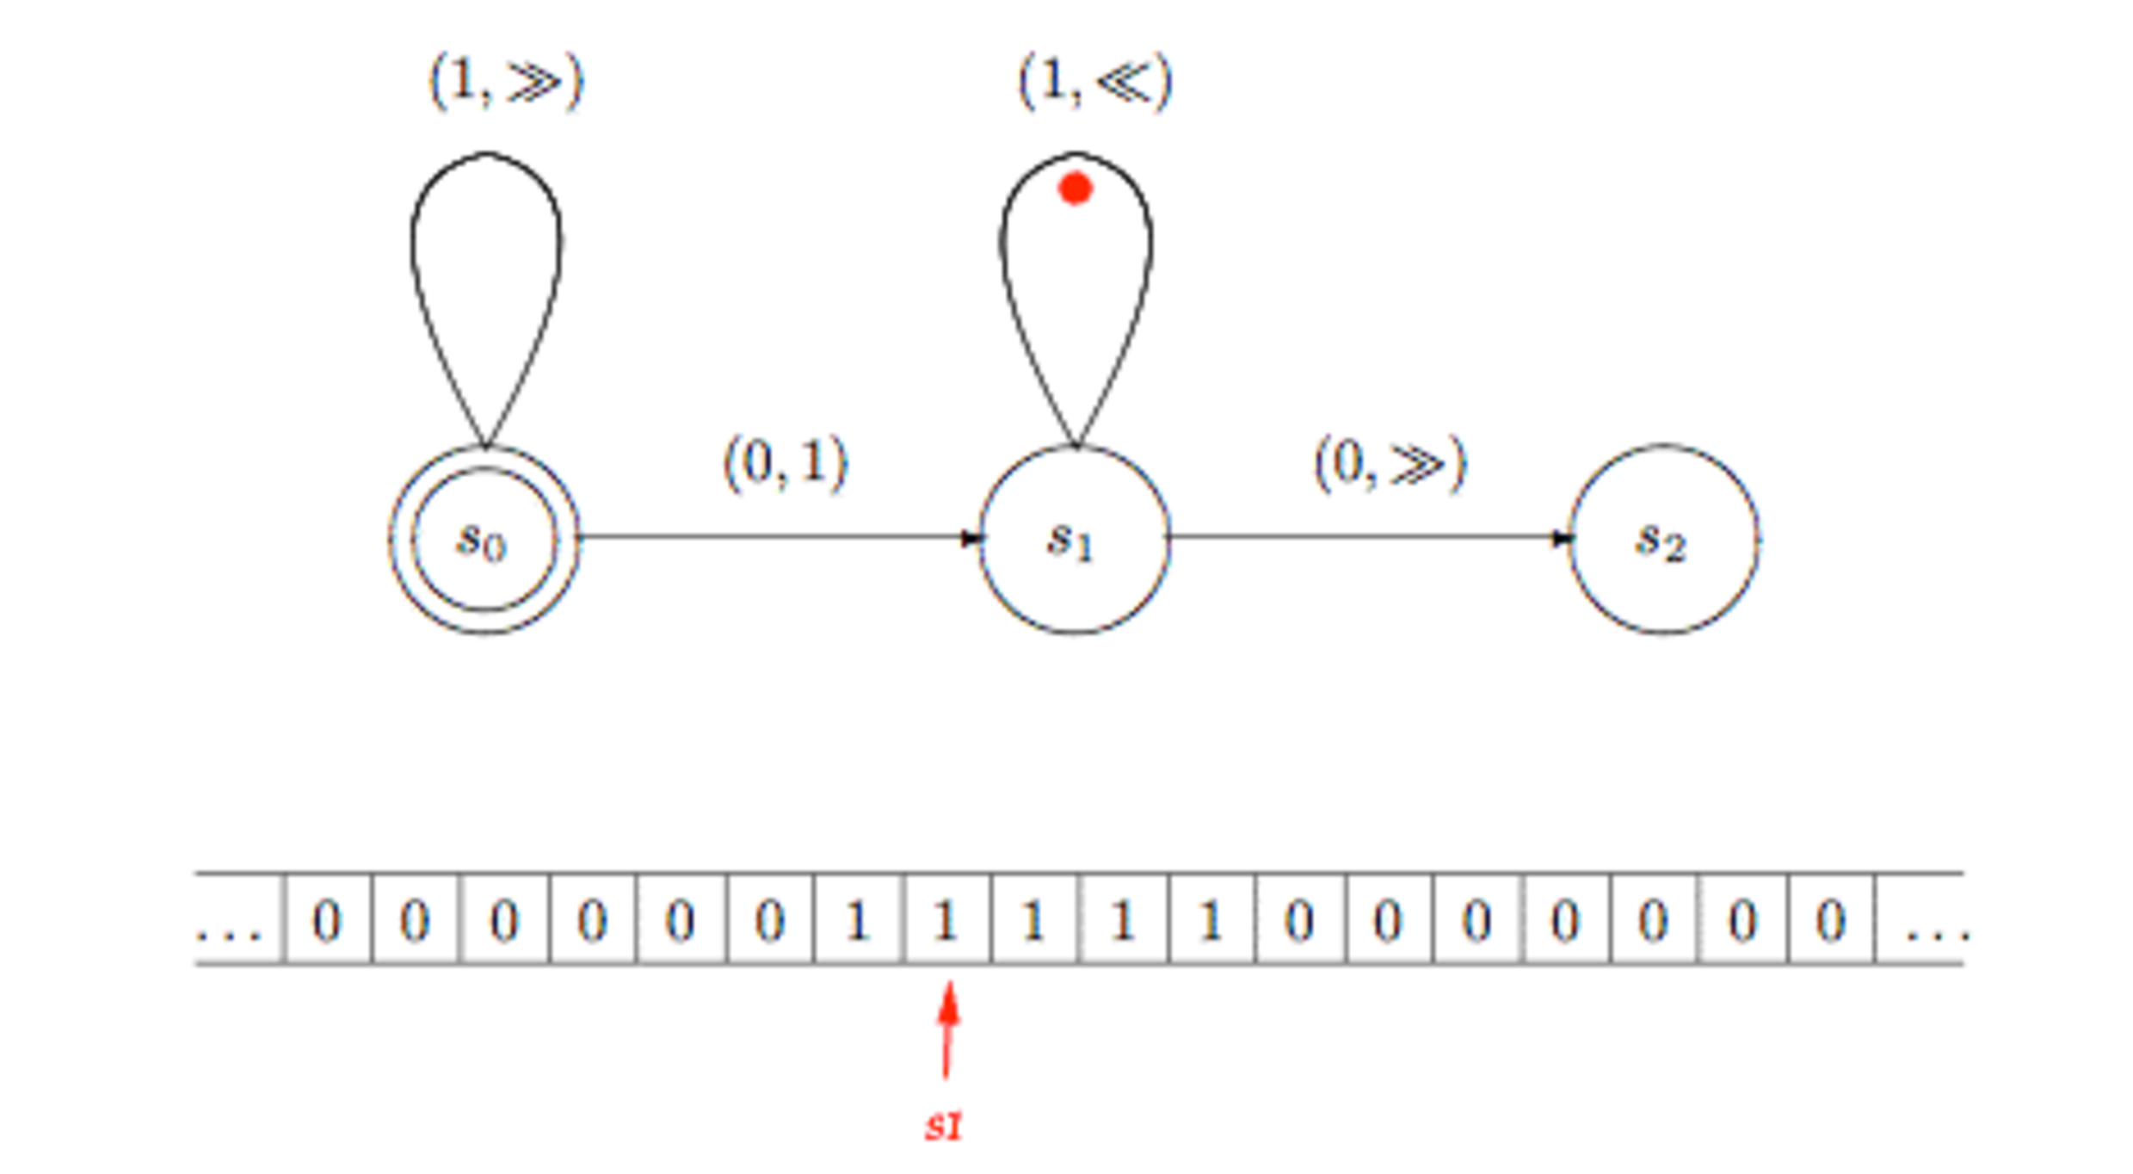

Slide 37
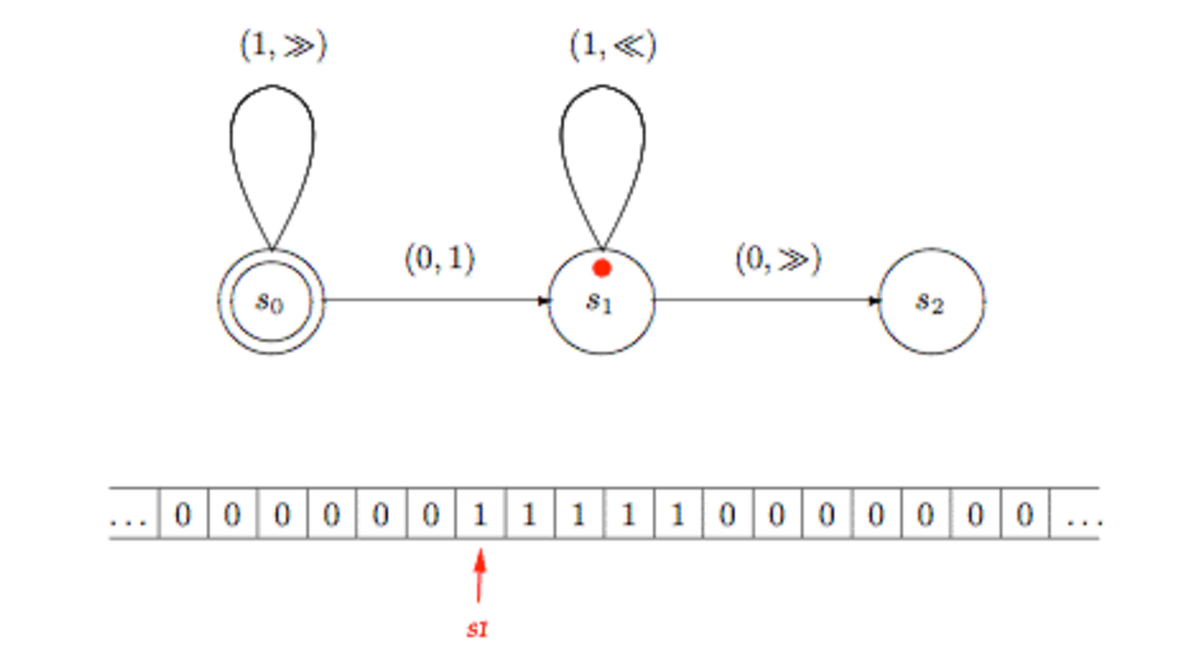

Slide 38
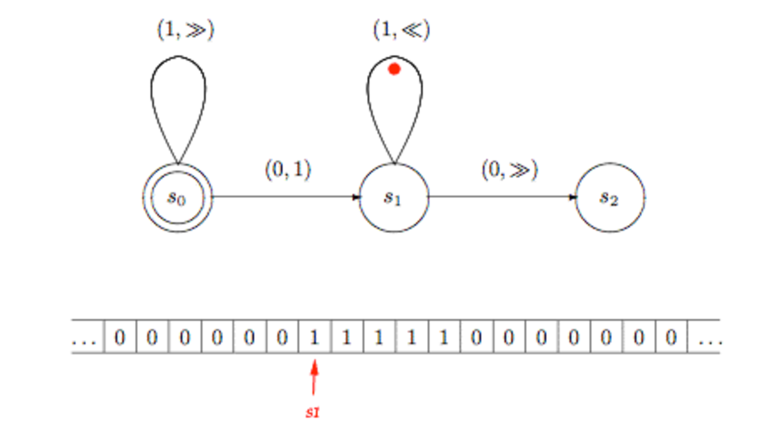

Slide 39
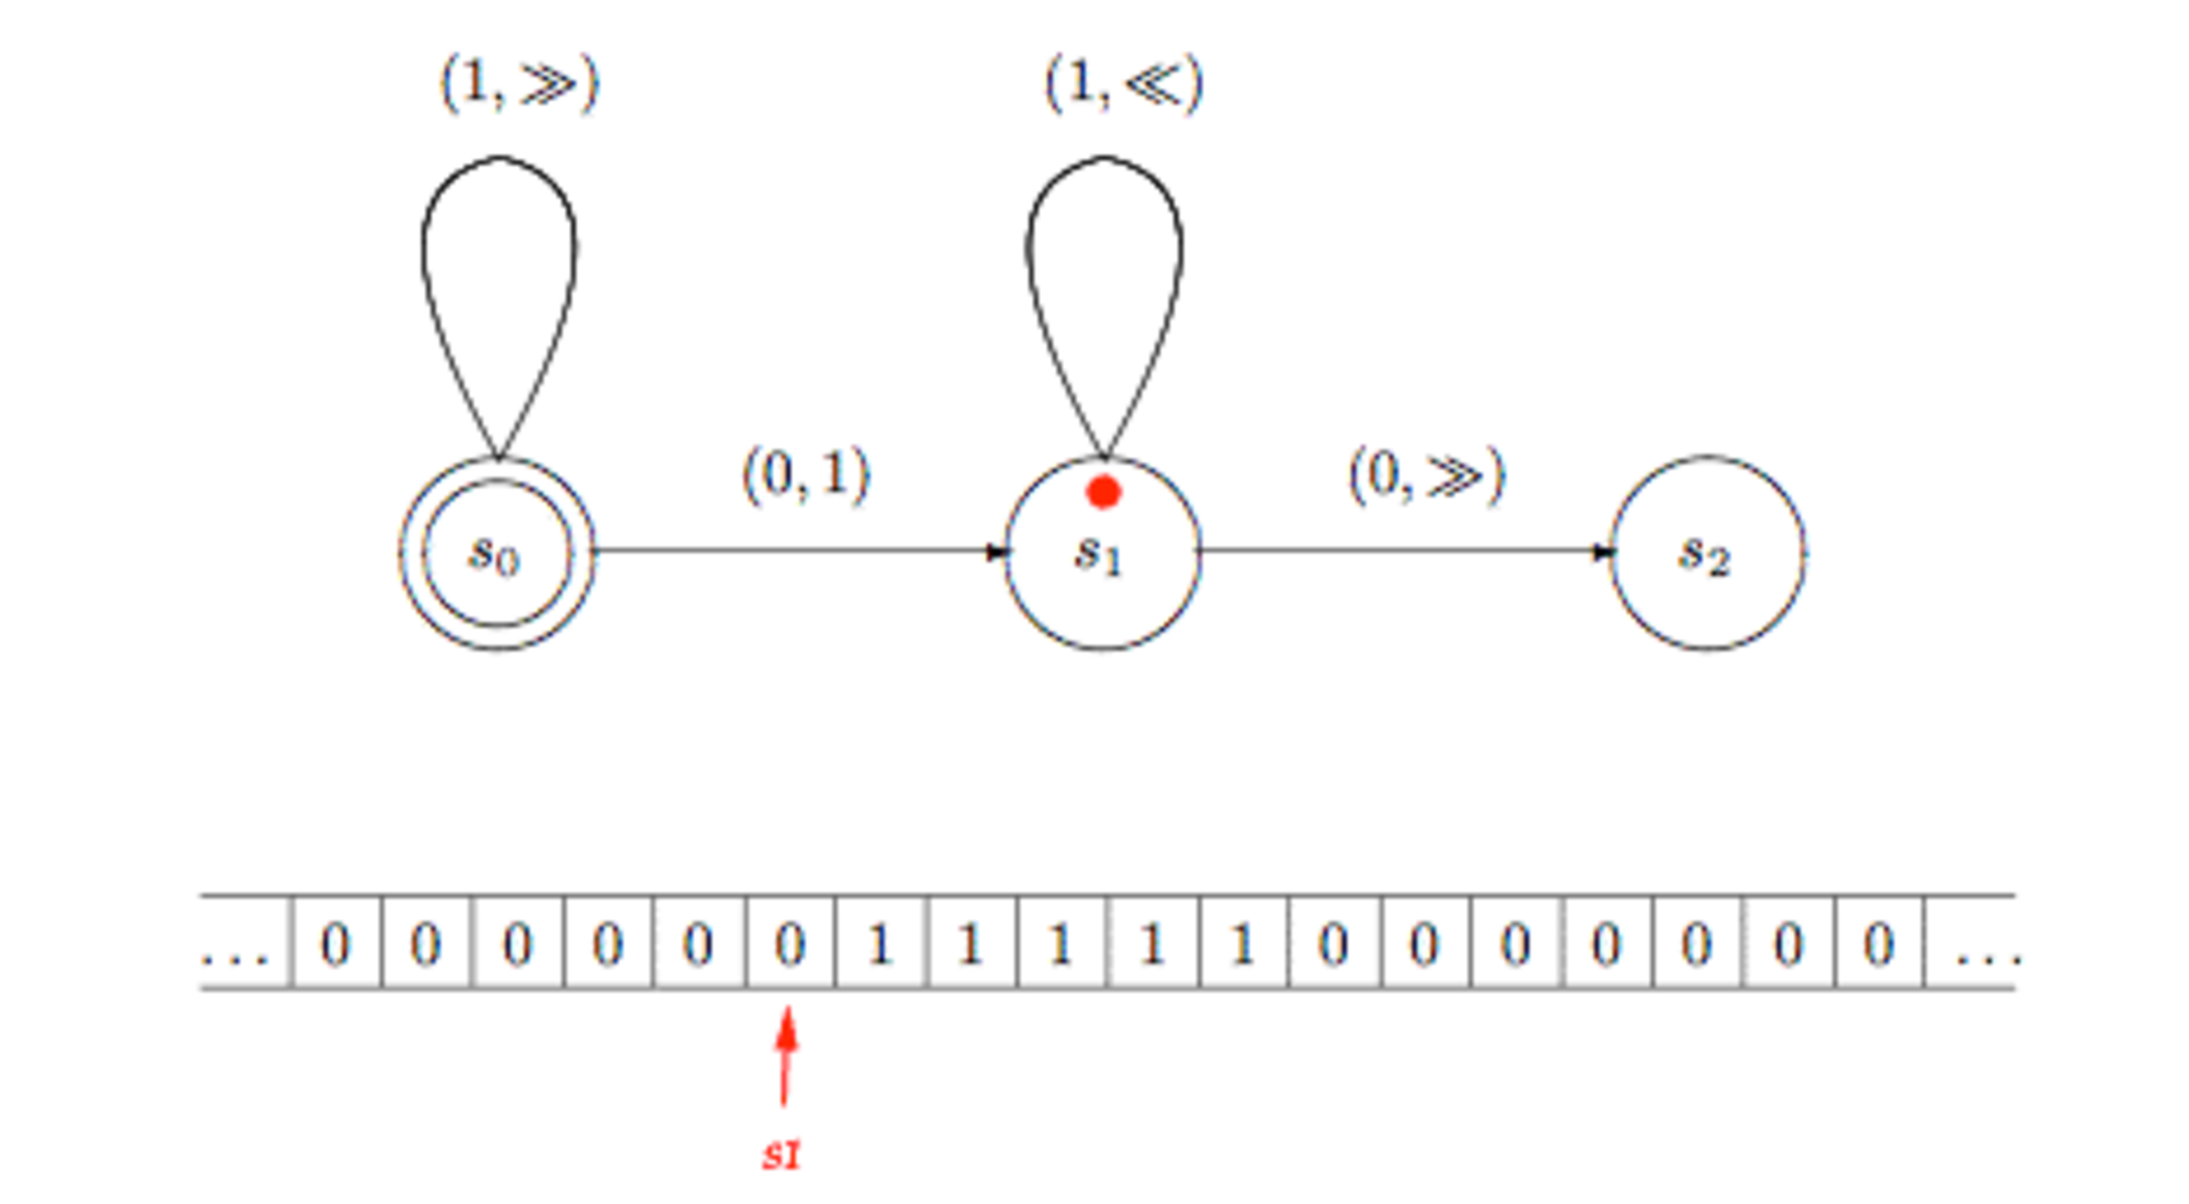

Slide 40
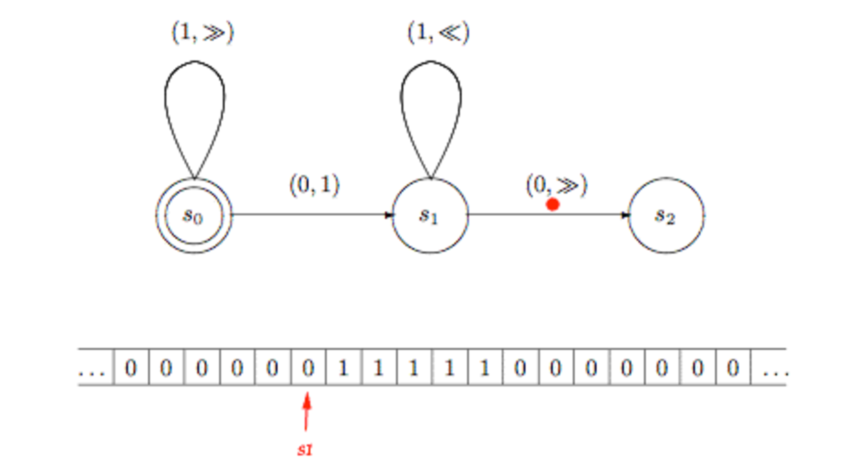

Slide 41
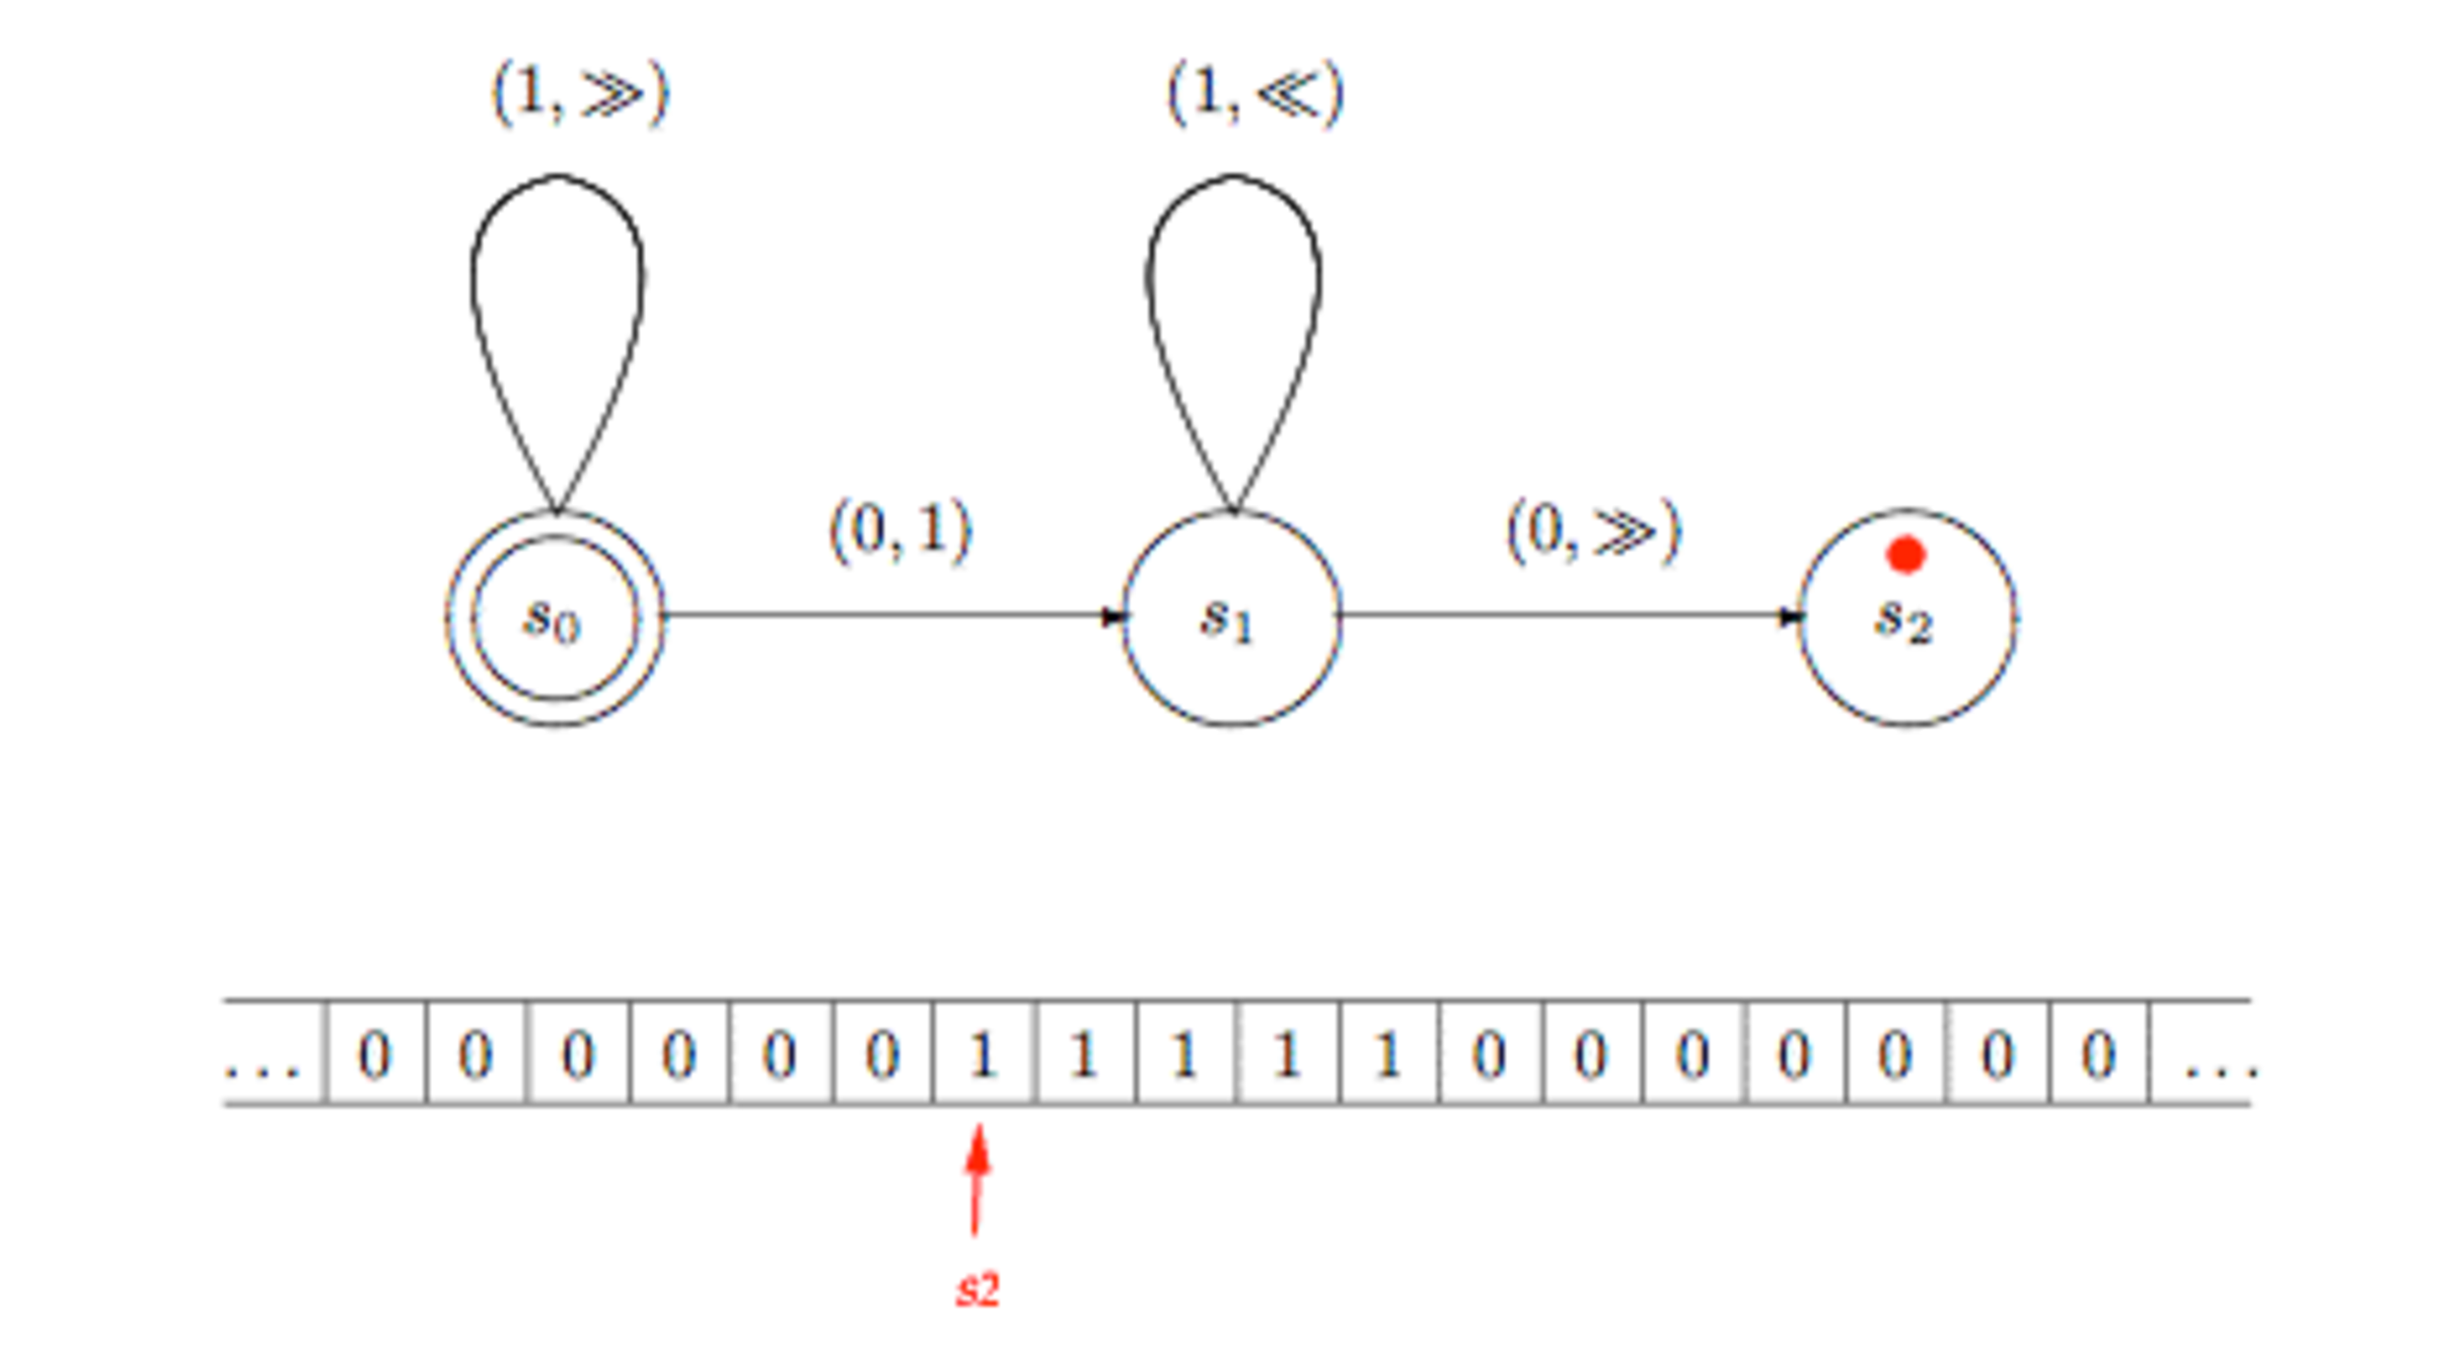

Slide 42
Question: what does it compute?

Slide 43
function succ (n) {
return n + 1;
}
(lambda (x) (+ x 1))

Slide 44
Successor (add-one) function assuming that number n as a block of n+1 copies of the symbol ‘1’ on the tape (here, n=3)

Slide 45
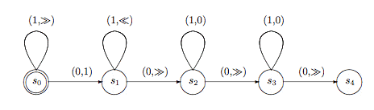
Addition of n+m
http://graphics.stanford.edu/~seander/bithacks.html
Maybe you prefer to use bit operations?

Slide 46
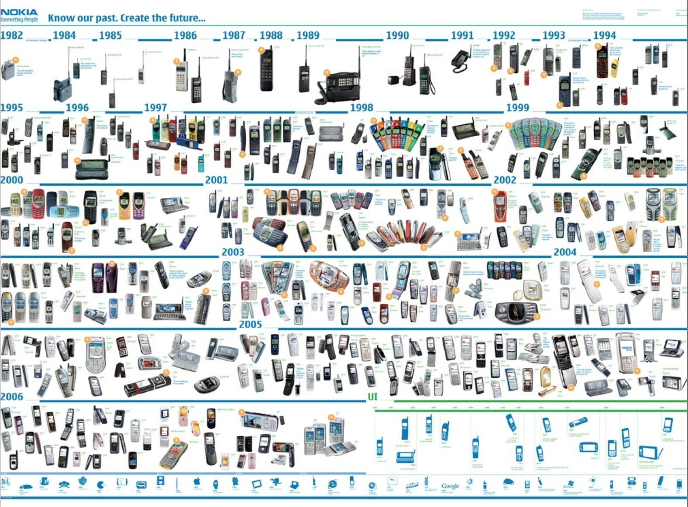





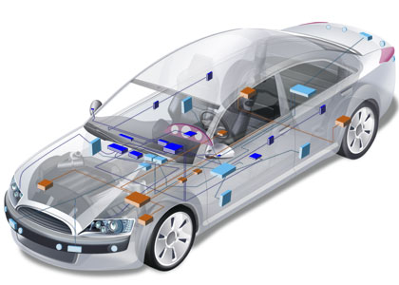

The (Hi)Story of Software Engineering / Computer Science
Notes:
http://plato.stanford.edu/entries/turing-machine/

Slide 47
Software
Languages
Notes:
http://plato.stanford.edu/entries/turing-machine/

Slide 48
Programming the Turing Machine Why aren’t we using tapes, states and transitions after all ?
Complex Systems
Distributed systems
Thousands of engineers/expertise
Web dev.
Large-scale systems
Critical Systems
Notes:
TODO: explain how does it work… GRAMMAR
Concurrency
Expressivness
Abstractions (*** insist ****)
collaborative ?
domain experts ?
…

Slide 49
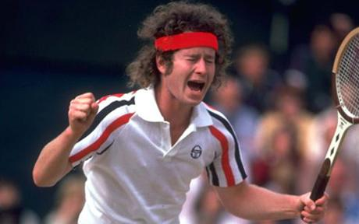
Programming the Turing Machine Why aren’t we using tapes, states and transitions after all ?
You cannot be serious
Notes:
TODO: explain how does it work… GRAMMAR
Concurrency
Expressivness
Abstractions (*** insist ****)
collaborative ?
domain experts ?
…

Slide 50
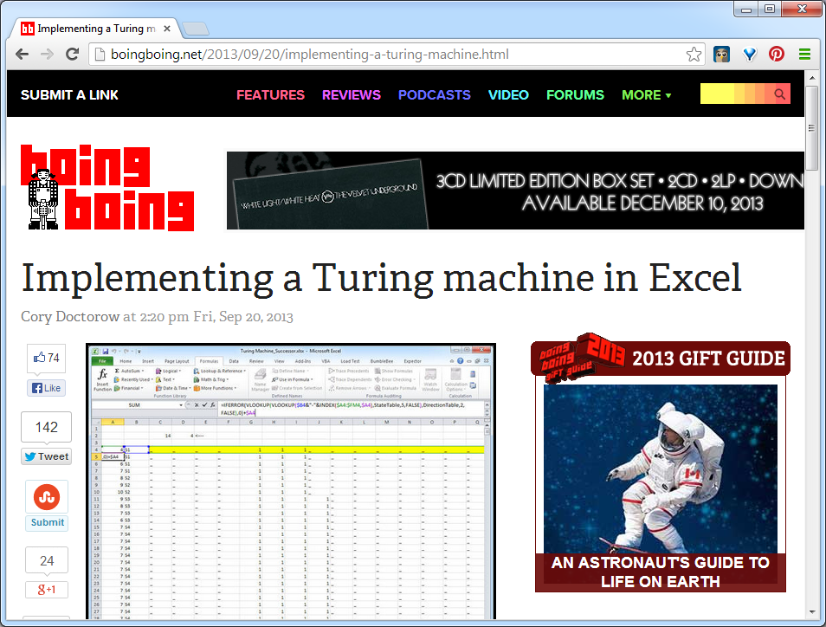
Formulas are Turing complete

Slide 51
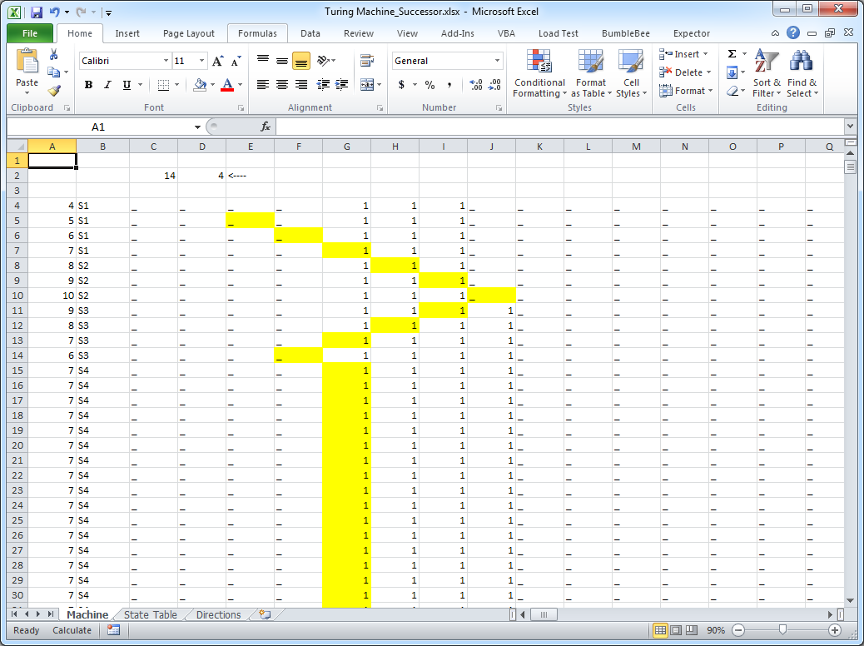
Formulas are Turing complete
Youtube video https://t.co/RTfJAxXYaX
http://fr.slideshare.net/Felienne/spreadsheets-are-code-online

Slide 52
Esoteric programming languages
Designed to test the boundaries of computer programming language design, as a proof of concept, as software art, or as a joke.
extreme paradigms and design decisions
Eg https://esolangs.org/wiki/Brainfuck
Usually, an esolang's creators do not intend the language to be used for mainstream programming.

Slide 53
(brainfuck) What does it compute?
++++++++++[>+++++++>++++++++++>+++<<<-]>++.>+.+++++++
..+++.>++.<<+++++++++++++++.>.+++.------.--------.>+.

Slide 54
Questions to the audience
Why assembly language is not the mainstream language?
Why spreadsheets are not used for building Google?
Why esoteric languages are not used for mainstream programming?
The answer to such « though-provoking » questions seems obvious at first glance
Help to define the good properties of software languages we expect
Help to understand why there is still innovation in language design

Slide 55
Programming the Turing Machine Why aren’t we using tapes, states and transitions after all ?
Software Languages
Hard to write and understand.
No abstractions.
Hard to debug and test.
Poor language constructs. Poor tooling support.
Performance.
Usability, productivity, reusability, safety, expressiveness, learnability.
Notes:
TODO: explain how does it work… GRAMMAR
Concurrency
Expressivness
Abstractions (*** insist ****)
collaborative ?
domain experts ?
…

Slide 56
Question: what does it compute?
Performance, usability, productivity, reusability, safety, expressiveness, learnability.

Slide 57
Qualities and challenges
Cognitive dimensions (see references after)
Abstractions
Eg Kramer “Abstraction and Modelling - A Complementary Partnership” MODELS’08
Separation of concerns/modularity
Eg Tarr et al., ICSE’99
Scalability
Growing a language (like Scala)
Performance
…

Slide 58

Complex Systems
Languages
Notes:
http://plato.stanford.edu/entries/turing-machine/

Slide 59
We need languages
At a high level of abstraction
Still general-purpose
Generation of other artefacts written in other languages
Transformation, refinement
Multiplicity of languages
Divide and conquer
Specific to a problem or “domain”
Induce a way to “compose” languages
(Combemale et al. “On the Globalization of Domain-Specific Languages”)

Slide 60

“Even variations in grammar can profoundly affect how we see the world.”
She’s talking about real languages; what about synthetic, programming languages?

Slide 61
What is a language?
« A system of signs, symbols, gestures, or rules used in communicating »
« The special vocabulary and usages of a scientific, professional, or other group »
« A system of symbols and rules used for communication with or between computers. »

Slide 62
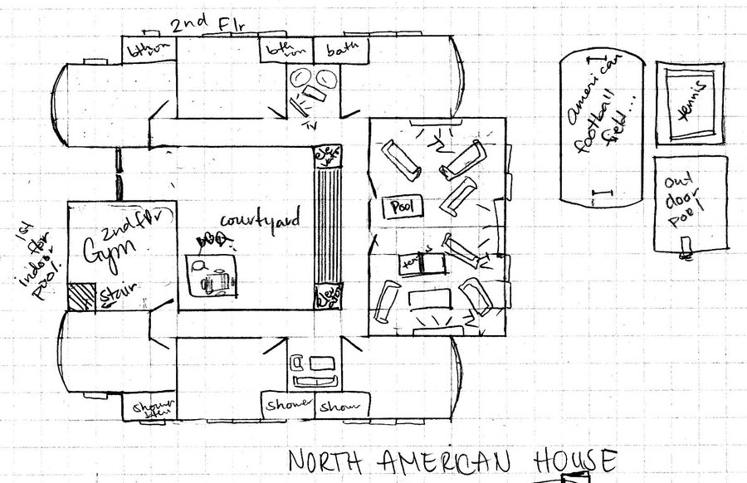


Architecture
Architecture

Slide 63


Cartography
Cartography

Slide 64




Biology
Biology

Slide 65





Electronics
Electronics

Slide 66
In Software Engineering
« Languages are the primary way in which system developers communicate, design and implement software systems »

Slide 67
General Purpose
Languages
Assembly ?
COBOL ? LISP ? C ? C++ ?
Java? PHP ? C# ? Ruby ?
Notes:
http://plato.stanford.edu/entries/turing-machine/

Slide 68




Limits of General Purpose Languages (1)
Abstractions and notations used are not natural/suitable for the stakeholders

Slide 69


Limits of General Purpose Languages (2)
Not targeted to a particular kind of problem, but to any kinds of software problem.

Slide 70
Domain Specific Languages
Targeted to a particular kind of problem, with dedicated notations (textual or graphical), support (editor, checkers, etc.)
Promises: more « efficient » languages for resolving a set of specific problems in a domain

Slide 71

A discussable view (slide “OptiML…” Sujeeth et al., ICML’11)

Slide 72
Domain Specific Languages (DSLs)
Long history: used for almost as long as computing has been done.
You’re using DSLs in a daily basis
You’ve learnt many DSLs in your curriculum
Examples to come!

Slide 73

HTML
Domain: web (markup)

Slide 74

CSS
Domain: web (styling)

Slide 75

SQL
Domain: database (query)

Slide 76

Makefile
Domain: software building

Slide 77

Lighthttpd configuration file
Domain: web server (configuration)

Slide 78


Graphviz
Domain: graph (drawing)

Slide 79


PGN (Portable Game Notation)
Domain: chess (games)

Slide 80

Regular expression
Domain: strings (pattern matching)

Slide 81
Question to the audience
Give three examples of domain-specific languages (DSLs)

Slide 82
OCL
self.questions->size
self.employer->size
self.employee->select (v | v.wages>10000 )->size
Student.allInstances
->forAll( p1, p2 |
p1 <> p2 implies p1.name <> p2.name )
Domain: model management

Slide 83








UML can be seen as a collection of domain-specific modeling languages
Structural
Behavioral

Slide 84
Abstraction Gap
Assembler
C, Java
Problem
Space
DSLs
Solution
Space

Slide 85
« Another lesson we should have learned from the recent past is that the development of 'richer' or 'more powerful' programming languages was a mistake in the sense that these baroque monstrosities, these conglomerations of idiosyncrasies, are really unmanageable, both mechanically and mentally.
I see a great future for very systematic and very modest programming languages »
ACM Turing Lecture, « The Humble Programmer » Edsger W. Dijkstra
aka General-Purpose Languages
aka Domain-Specific Languages
1972

Slide 86


« Domain-specific languages are far more prevalent than anticipated »
2011

Slide 87


2011

Slide 88
What is a domain-specific language ?
« Language specially designed to perform a task in a certain domain »
« A formal processable language targeting at a specific viewpoint or aspect of a software system. Its semantics and notation is designed in order to support working with that viewpoint as good as possible »
« A computer language that's targeted to a particular kind of problem, rather than a general purpose language that's aimed at any kind of software problem. »

Slide 89
GPL (General Purpose Language)
A GPL provides notations that are used to describe a computation in a human-readable form that can be translated into a machine-readable representation.
A GPL is a formal notation that can be used to describe problem solutions in a precise manner.
A GPL is a notation that can be used to write programs.
A GPL is a notation for expressing computation.
A GPL is a standardized communication technique for expressing instructions to a computer. It is a set of syntactic and semantic rules used to define computer programs.

Slide 90
What is offered?
Promises of domain-specific languages
Higher abstractions
Avoid redundancy
Separation of concerns
Use domain concepts

Slide 91
Promises of domain-specific languages
Benefits
Quality
V&V
Communication
Domain Expert
No Overhead
Platform Independent
Productivity

Slide 92


General PLs vs Domain-SLs
GeneralPL vs DomainSL
The boundary isn’t as clear as it could be. Domain-specificity is not black-and-white, but instead gradual: a language is more or less domain specific

Slide 93
Specializing syntax and environment pays off?
Promises of DSL« improvement » in terms of
usability, learnability, expressiveness, reusability, etc.
Empirical study on the role of syntax
C-style syntax induces problems in terms of usability for novices; language more or less intuitive for (non-)programmers (Stefik et al. 2014)
Syntax issues with Java for students (Denny et al. 2011)
PL usability: method namings/placement, use of identifiers, API design (Ellis et al., Styllos et al., Clarke, Montperrus et al., etc.)
More specialized/sophicated tools/IDE can be derived from a DSL
editors, compilers, debuggers

Slide 94
Question to the audience
Take one DSL and formulate assumptions on their qualities (and superiority to a GPL-based solution)
Imagine an experience for providing evidence that the DSL has such qualities

Slide 95
External DSLs vs Internal DSLs
An external DSL is a completely separate language and has its own custom syntax/tooling support (e.g., editor)
An internal DSL is more or less a set of APIs written on top of a host language (e.g., Java).
Fluent interfaces

Slide 96


External vs Internal DSL (SQL example)

Slide 97


Internal DSL (LINQ/C# example)

Slide 98
Internal DSL
« Using a host language (e.g., Java) to give the host language the feel of a particular language. »
Fluent Interfaces
« The more the use of the API has that language like flow, the more fluent it is »

Slide 99

SQL in… Java DSL in GPL

Slide 100

Regular expression in… Java DSL in GPL

Slide 101
Internal DSLs vs External DSL
Both internal and external DSLs have strengths and weaknesses
learning curve,
cost of building,
programmer familiarity,
communication with domain experts,
mixing in the host language,
strong expressiveness boundary
Focus of the course
external DSL a completely separate language with its own custom syntax and tooling support (e.g., editor)

Slide 102
Question to the audience
Find a DSL that is both internal and external
Notes:
HTML
Log4J properties

Slide 103

HTML
External DSL: <html>….
Internal DSLs
LISP
Scala (XML support included in the language)

Slide 104




Scala
TCS Wyvern (Omar et al., OOPLSA’14)
https://github.com/julienrf/glitter

Slide 105
SQL

Slide 106
Homework

Slide 107
Homework
Jhipster (http://www.jhipster.tech/), let us consider the “last” version (September 6, 2017)
How many languages are used in such a contemporary project?
List all software languages used in Jhipster
Classify them (GPL? External DSL? Internal DSL?)
Don’t forget APIs that look like (internal) DSLs
http://tinyurl.com/jhipster-langs1718
(deadline: next course)

Slide 108
References
Martin Fowler. Domain Specific Languages. Addison-Wesley Professional, 2010.
Markus Voelter et al. “DSL Engineering: Designing, Implementing and Using Domain-Specific Languages.” dslbook.org, 2013.
Kramer “Abstraction and Modelling - A Complementary Partnership” MODELS’08
Tarr et al. “N Degrees of Separation: Multi-Dimensional Separation of Concerns” ICSE’99
Benoit Combemale, Julien Deantoni, Benoit Baudry, Robert France, Jean-Marc Jézéquel, and Jeff Gray. « Globalizing Modeling Languages.” Computer, 2014.

Slide 109
References
Leo A Meyerovich and Ariel S Rabkin. “Empirical analysis of programming language adoption” OOPSLA’13
Felienne Hermans, Martin Pinzger, and Arie van Deursen. “Domain-Specific languages in practice: A user study on the success factors.“ MODELS’09
Paul Denny, Andrew Luxton-Reilly, Ewan Tempero, and Jacob Hendrickx. “Understanding the syntax barrier for novices.” ITiCSE ’11
Tiark Rompf et al . “Optimizing Data Structures in High-Level Programs: New Directions for Extensible Compilers based on Staging” POPL’13

Slide 110
References
Mathieu Acher, Benoît Combemale, Philippe Collet: “Metamorphic Domain-Specific Languages: A Journey into the Shapes of a Language.” Onward! 2014
Jeffrey Stylos and Brad A. Myers. “The implications of method placement on api learnability” FSE’08
Martin Monperrus, Michael Eichberg, Elif Tekes, and Mira Mezini. “What Should Developers Be Aware Of? An Empirical Study on the Directives of API Documentation”. Empirical Software Engineering, 17(6):703–737, 2012.

Slide 111
Plan
Domain-Specific Languages (DSLs)
Languages and abstraction gap
Examples and rationale
DSLs vs General purpose languages, taxonomy
External DSLs
Grammar and parsing
Xtext
DSLs, DSMLs, and (meta-)modeling

Slide 112
Contract
Better understanding/source of inspiration of software languages and DSLs
Revisit of history and existing languages
Foundations and practice of Xtext
State-of-the-art language workbench (Most Innovative Eclipse Project in 2010, mature and used in a variety of industries)
Models and Languages
Perhaps a more concrete way to see models, metamodels and MDE (IDM in french)

